Slide 1
MERA (Multi Scale Entanglement Renormalization Ansatz)
Abhilash, Daksh, Monu, Punyam
SPS, NISER
Guide- Dr. Anamitra Mukharjee

Slide 2
Building Blocks:
Tensor Networks

Slide 3
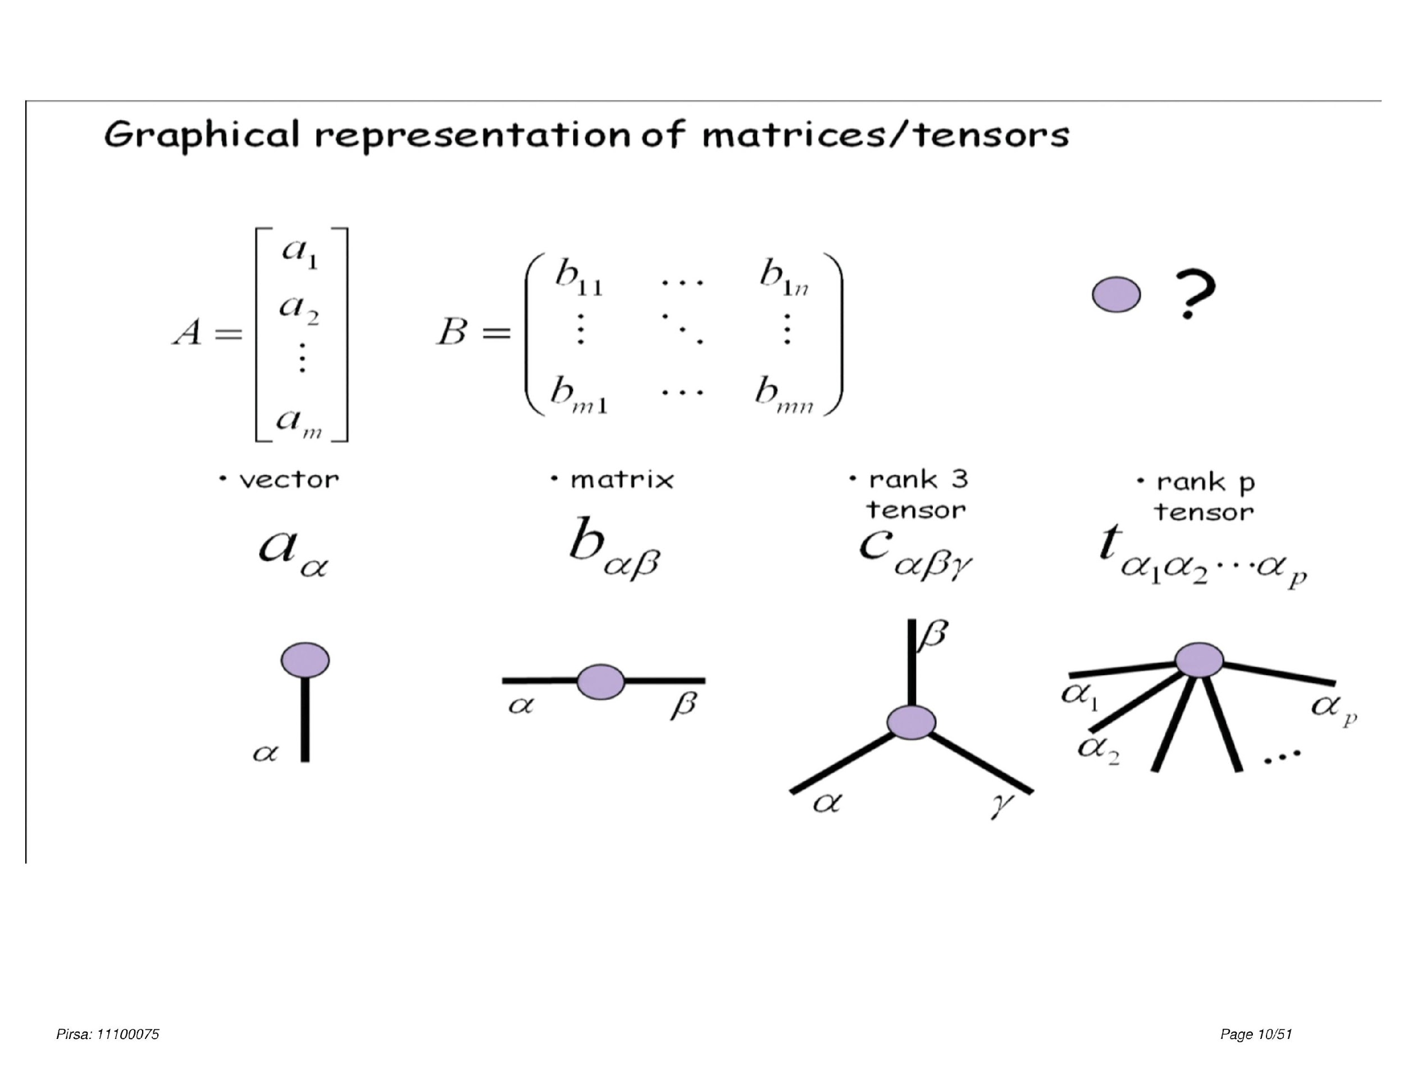
Tensor Networks

Slide 4
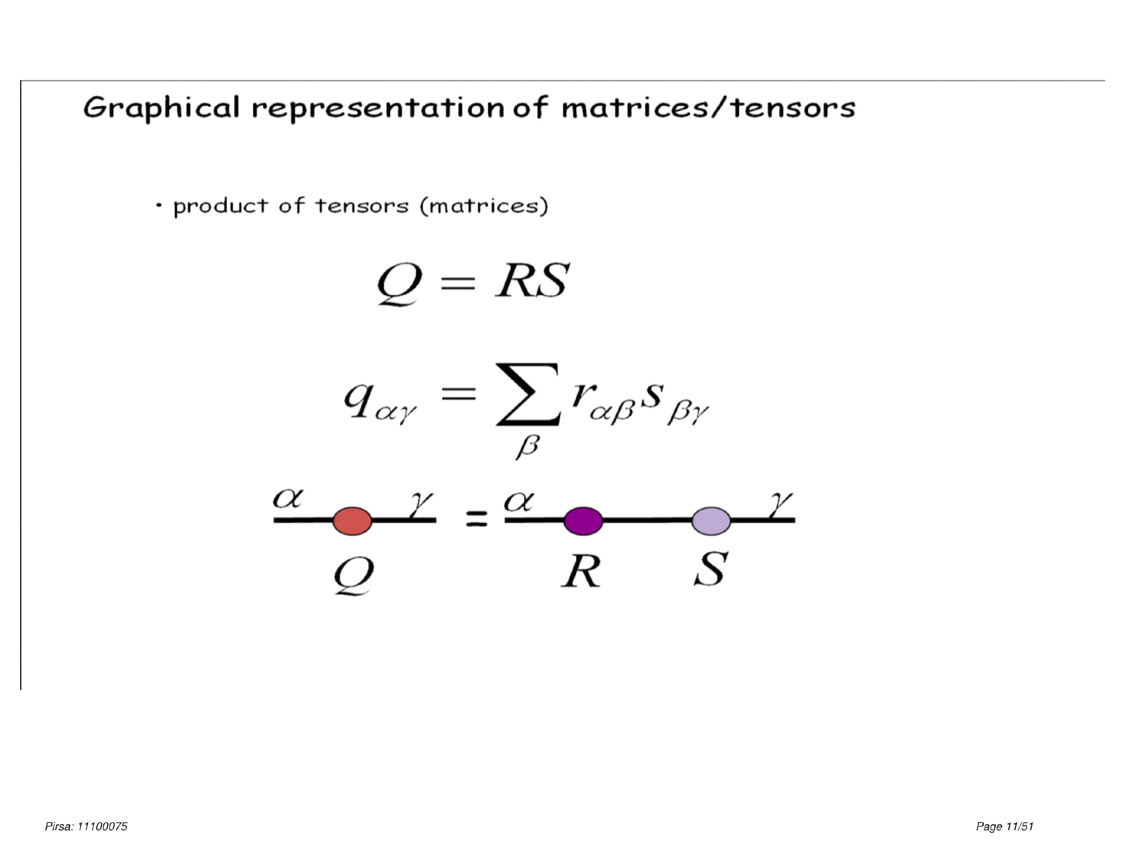
Tensor Networks

Slide 5
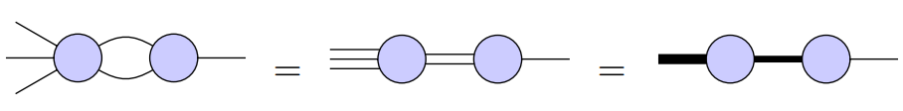
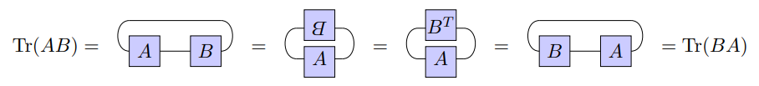
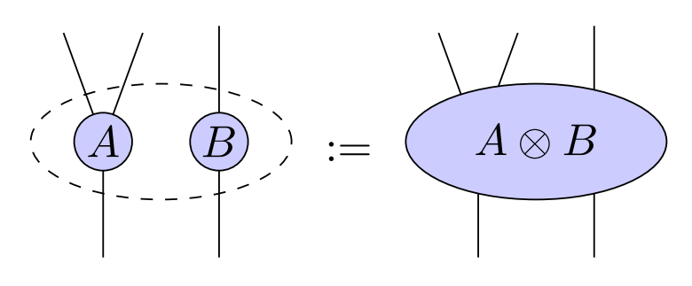
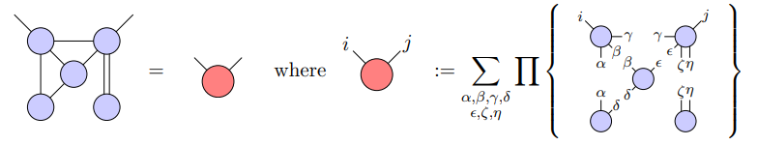
Tensor Networks
Some basic Tensor Operations

Slide 6
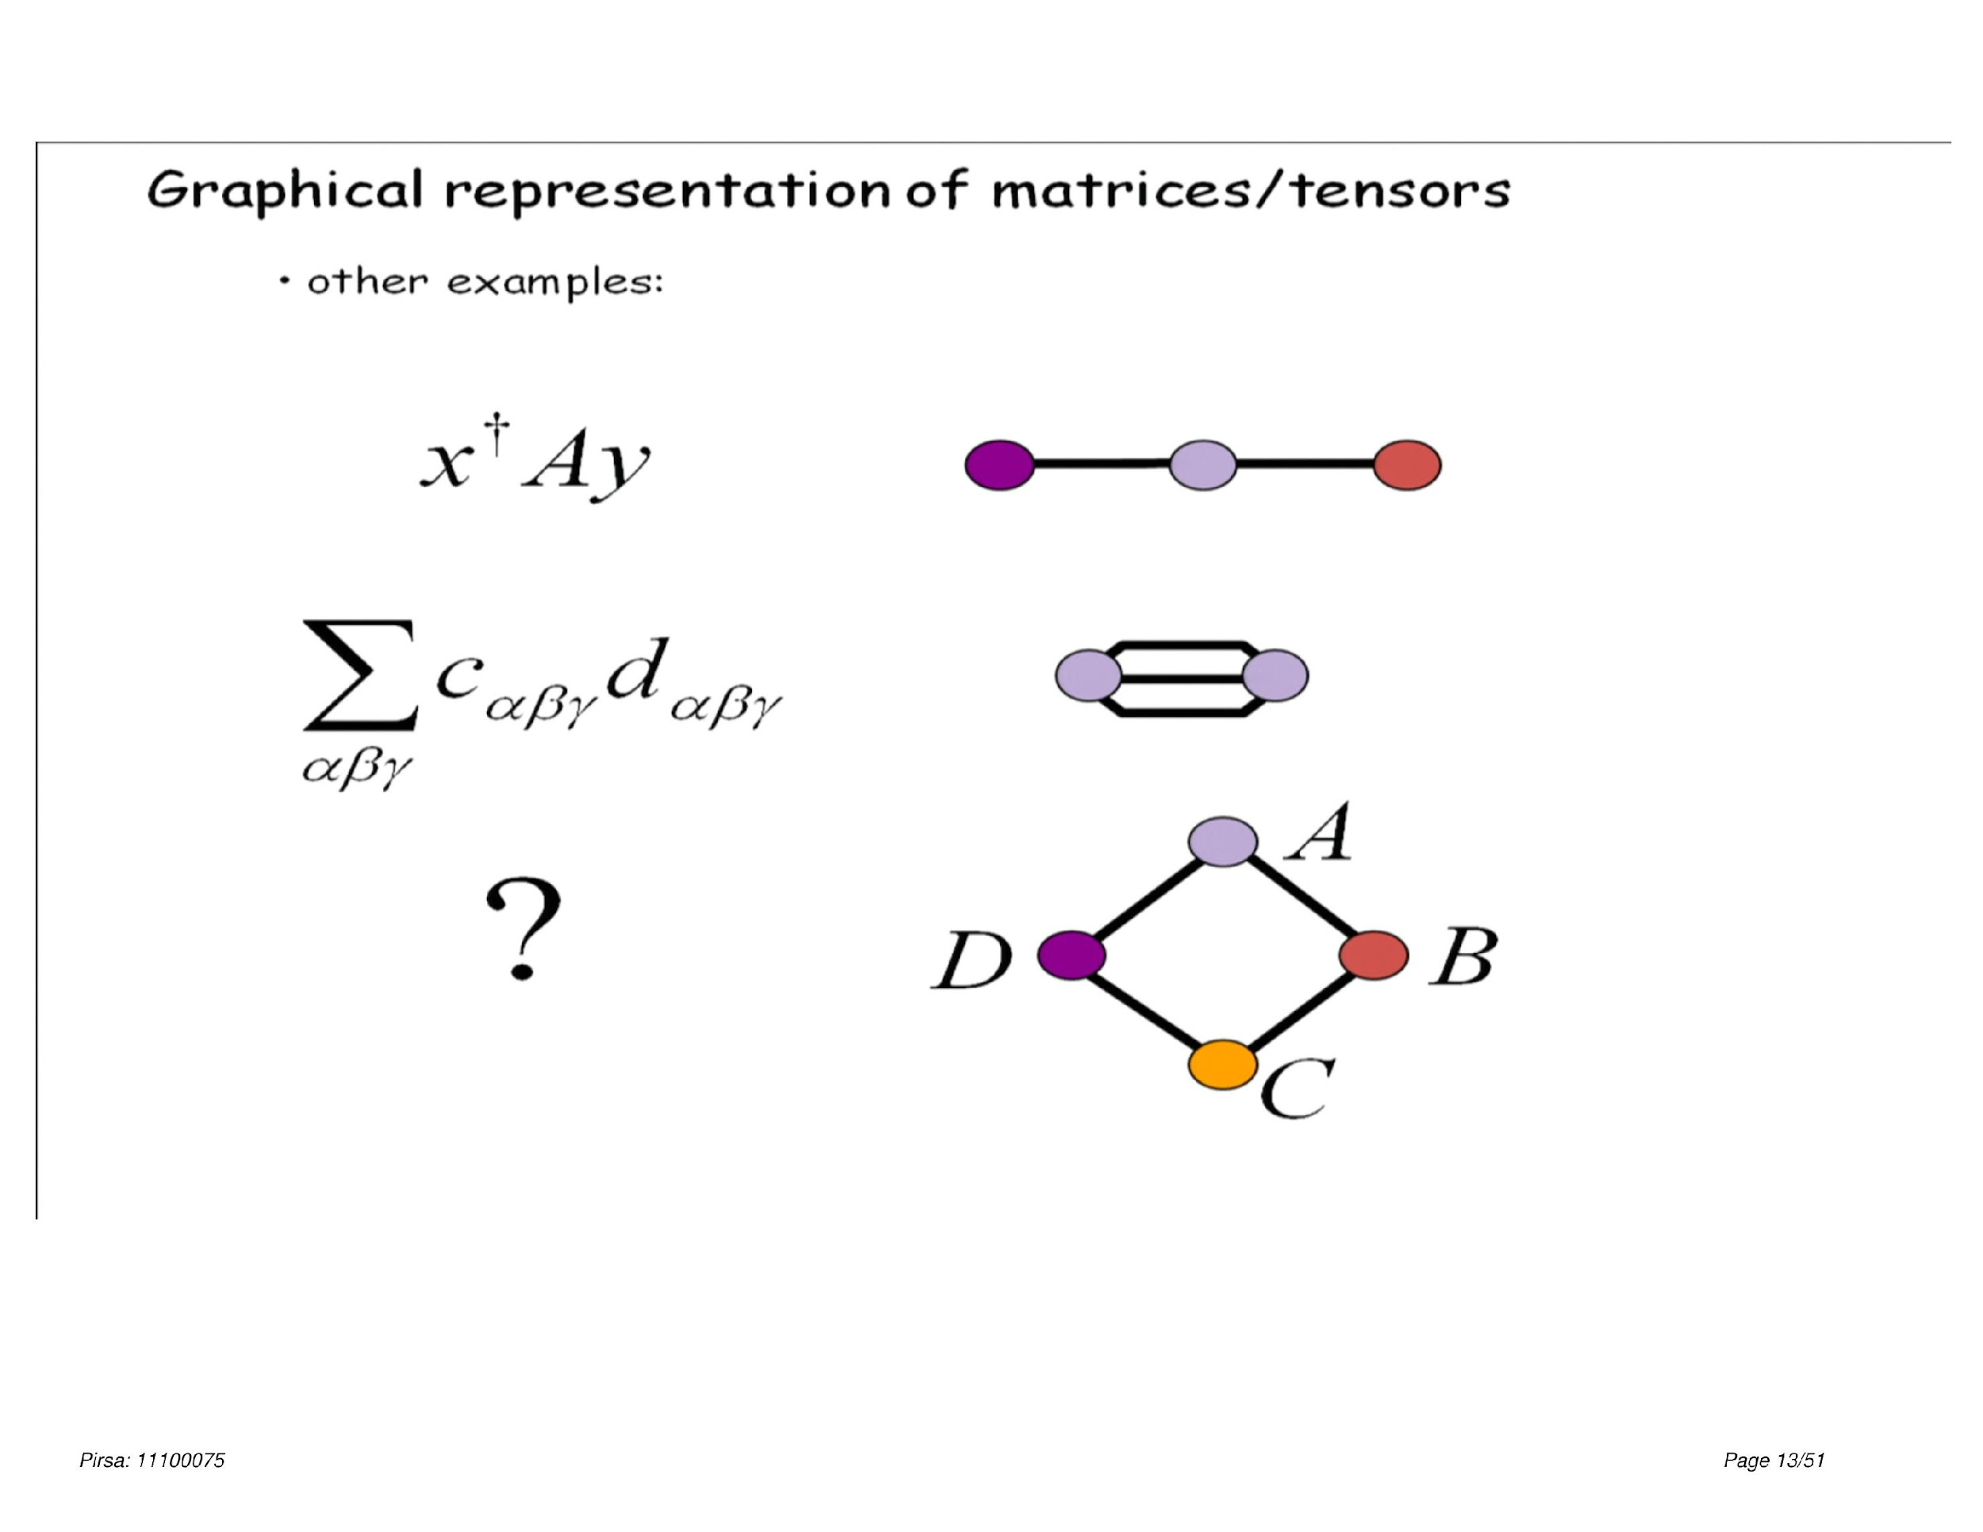
Tensor Networks
∑_{ijkl} = A_{li}B_{ij}C_{jk}D_{kl}

Slide 7
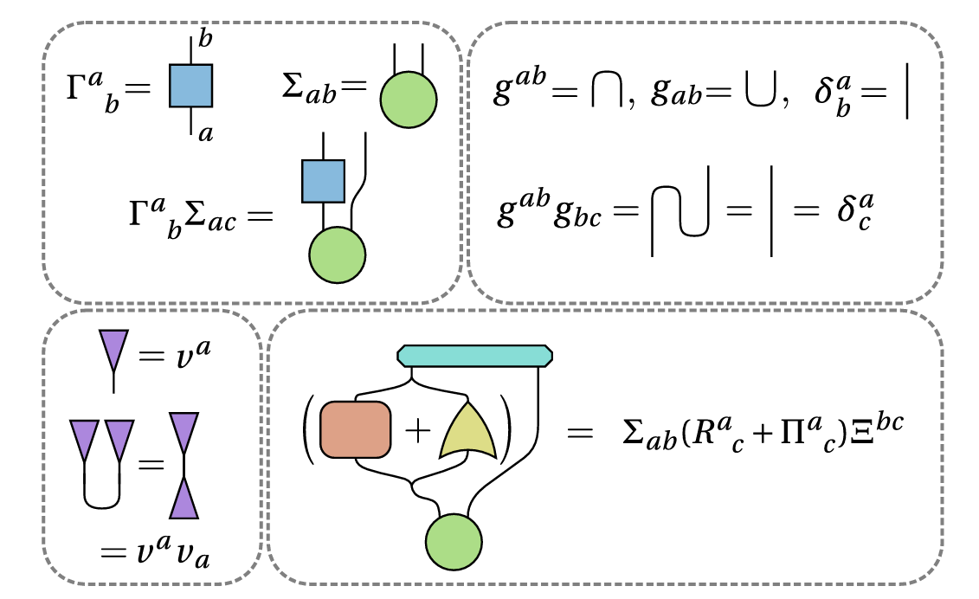
Tensor Networks
Summary

Slide 8
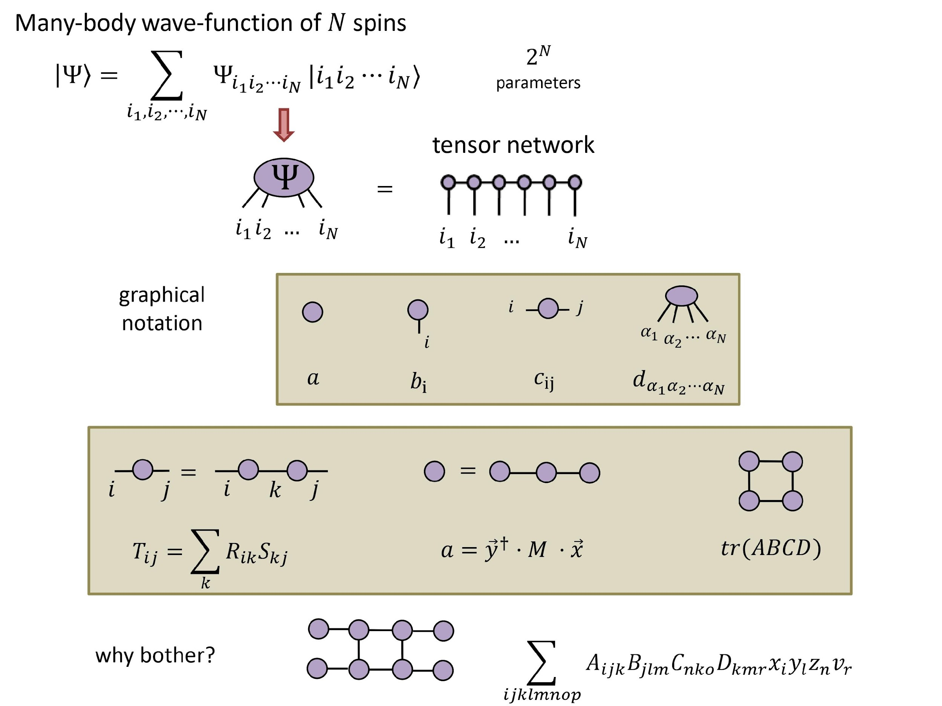
Tensor Networks

Slide 9
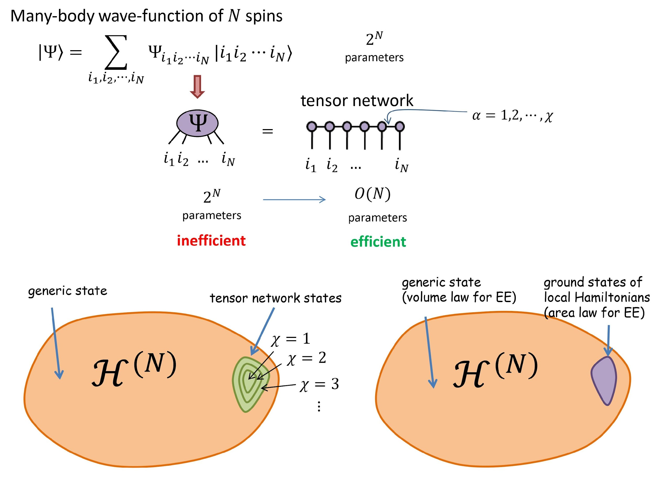
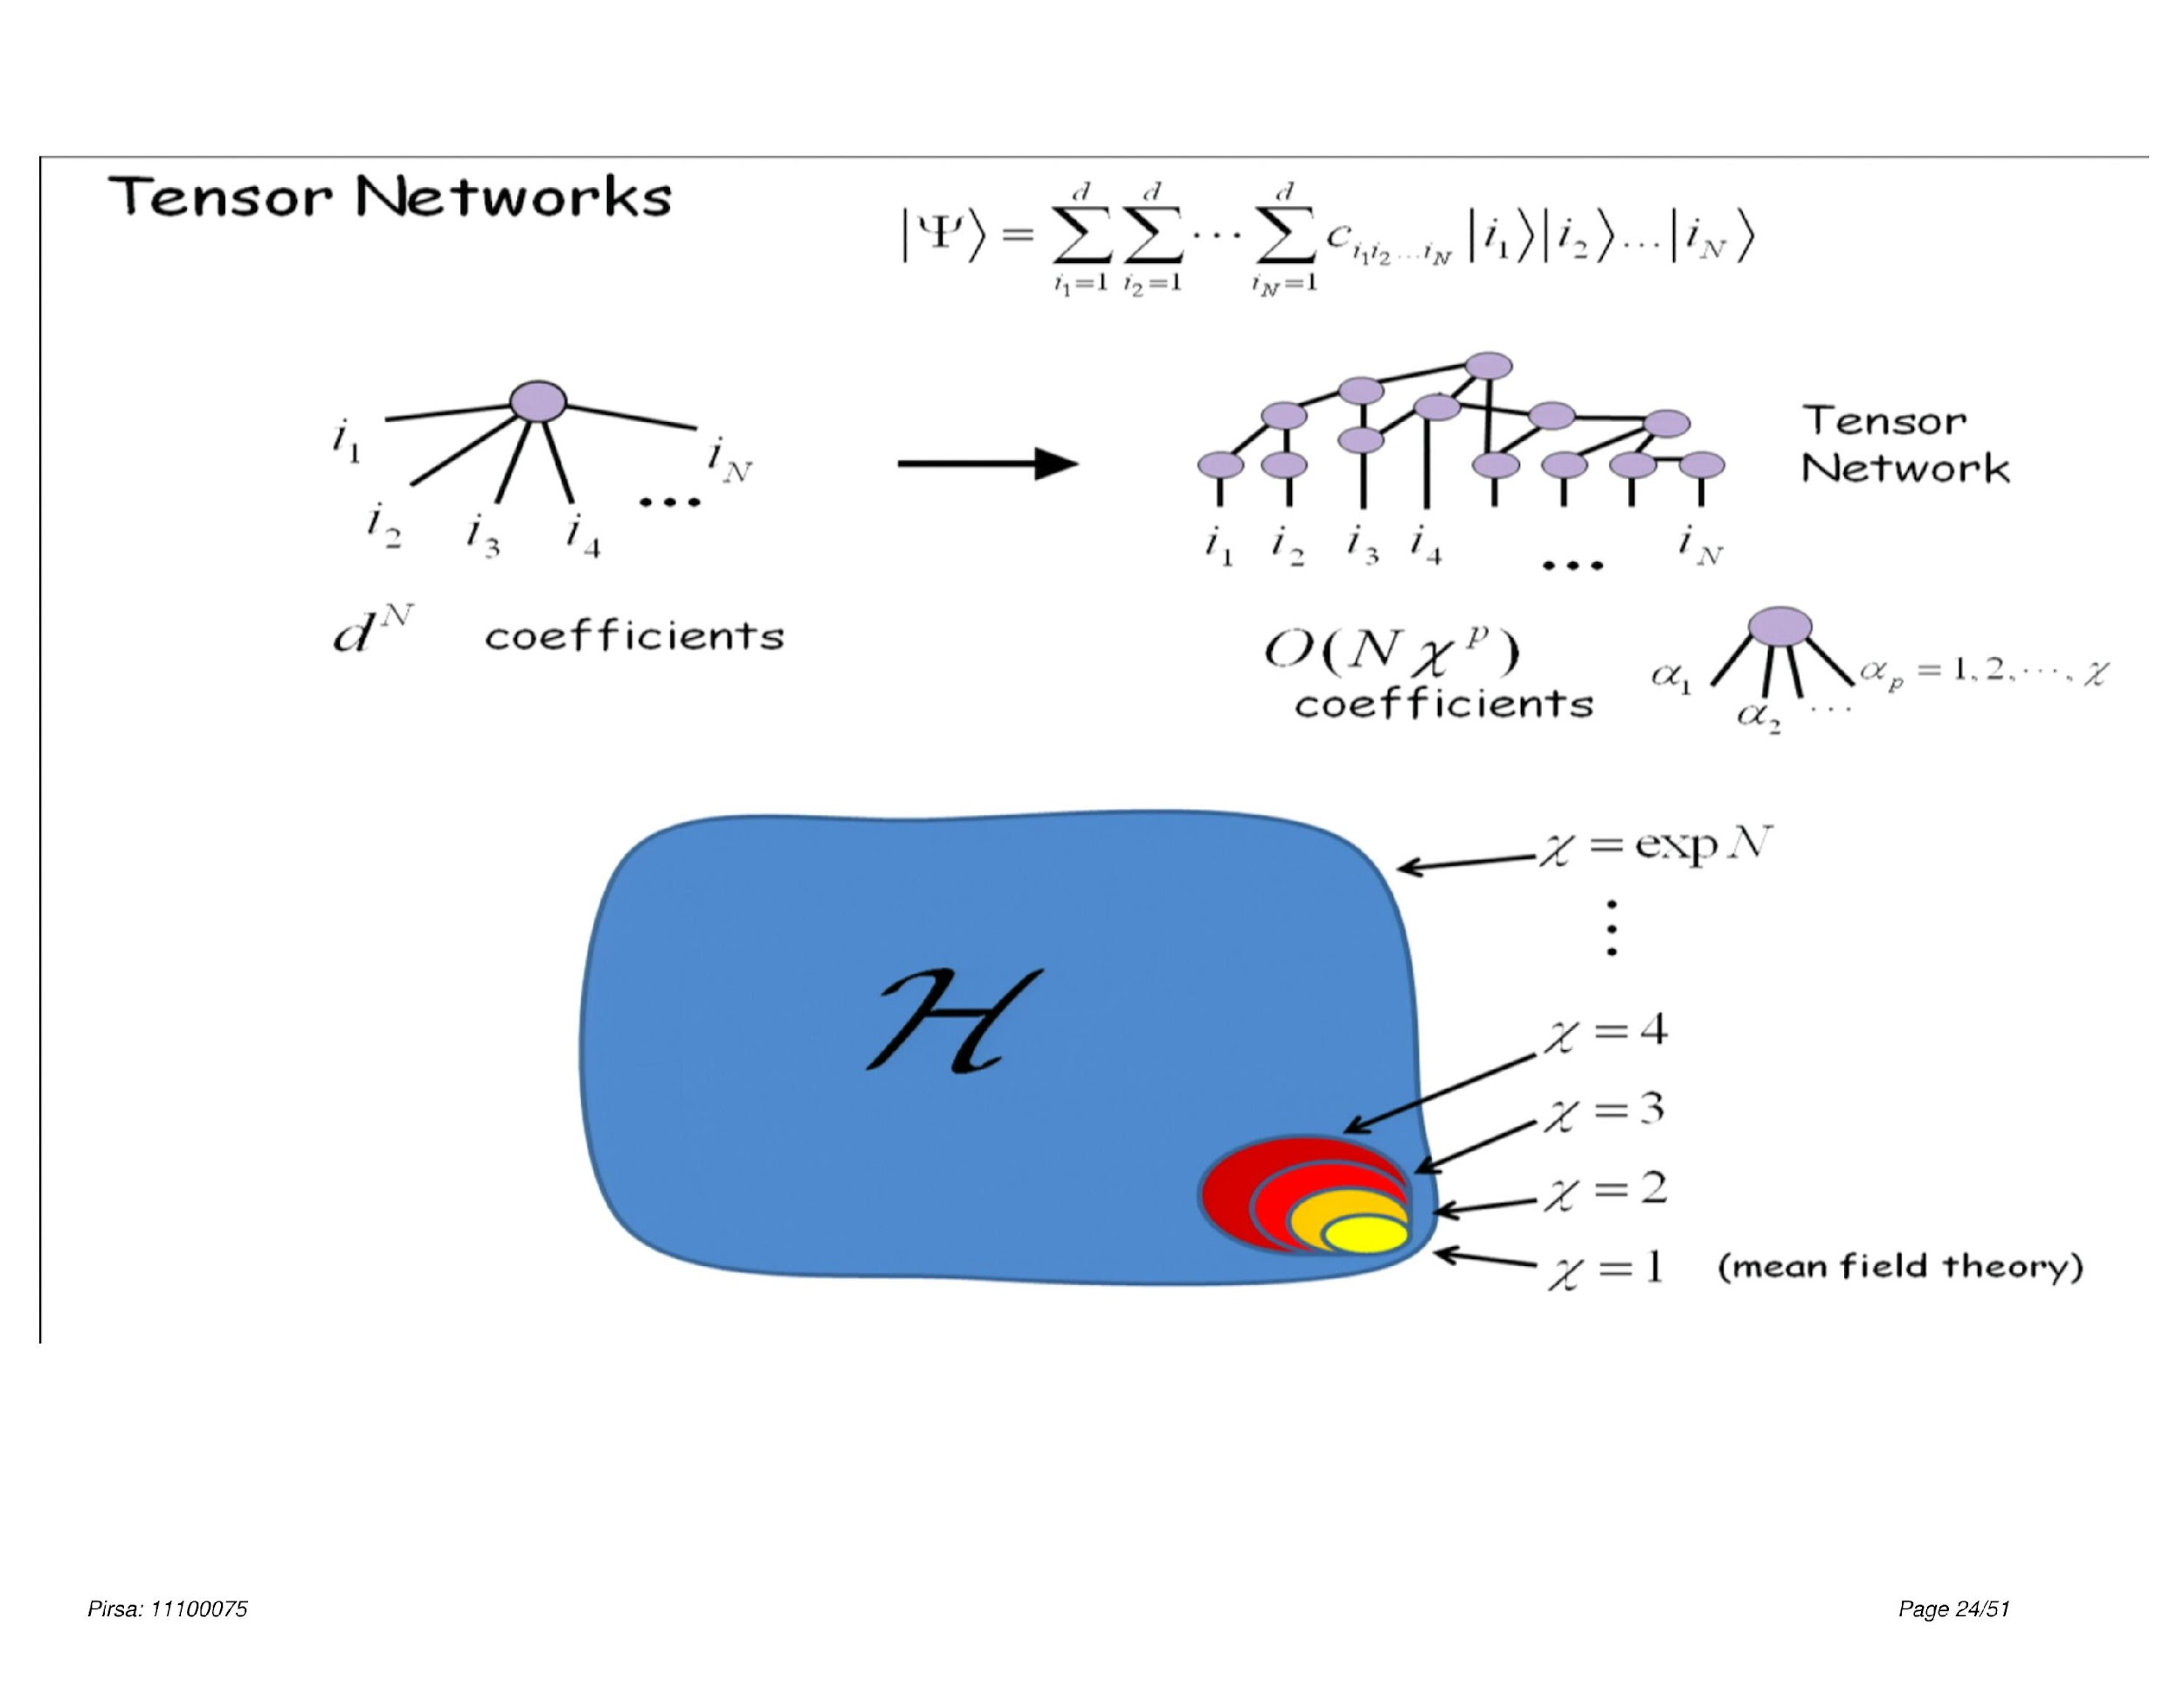
Tensor Networks

Slide 10
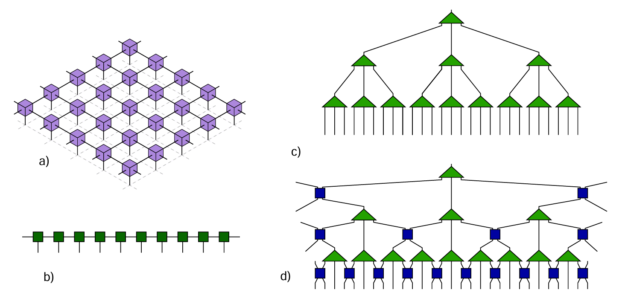
Tensor Networks
Types of Tensor Networks
PEPS
MPS
MERA

Slide 11
Tensor Networks
The Process Of Renormalization

Slide 12
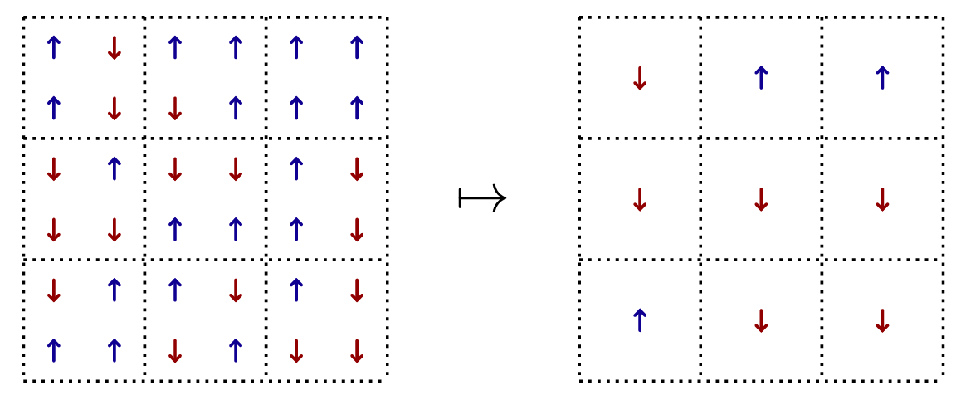
Renormalization
Kadanoff’s Block-spin tr.

Slide 13
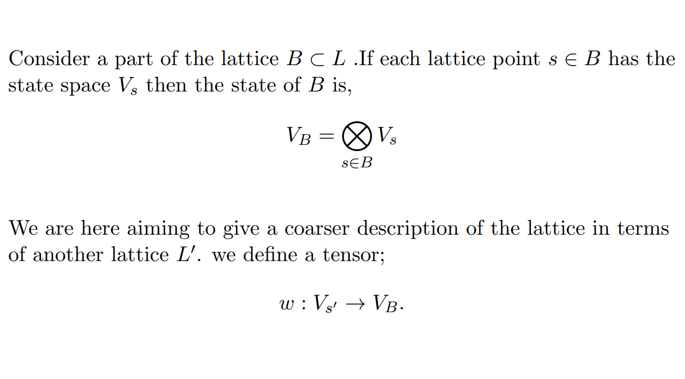
Renormalization
Coarse-graining of 1D lattice

Slide 14
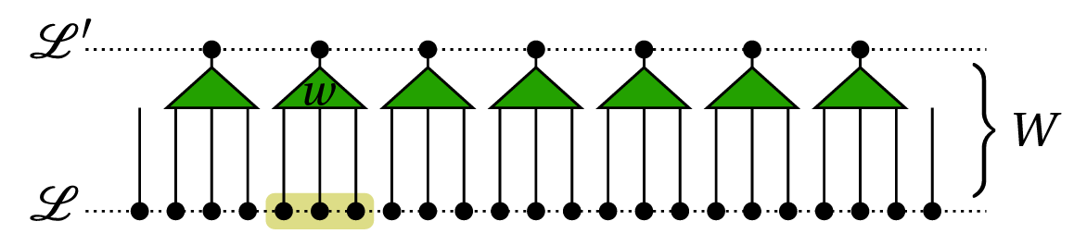
Renormalization
Coarse-graining of 1D lattice

Slide 15
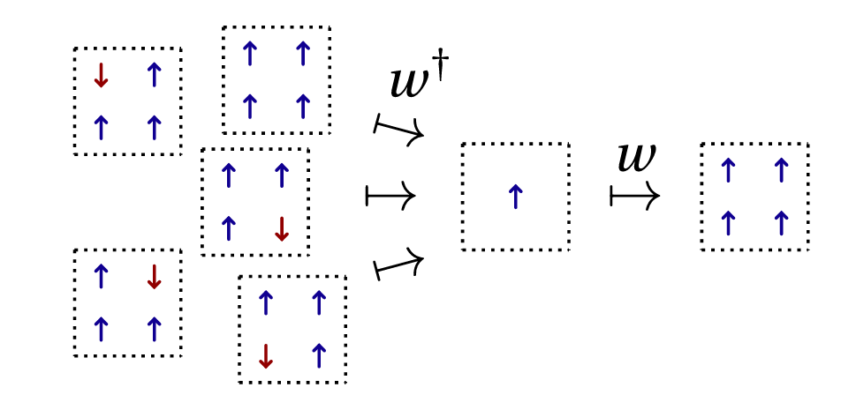
Renormalization
Coarse-graining of 1D lattice

Slide 16
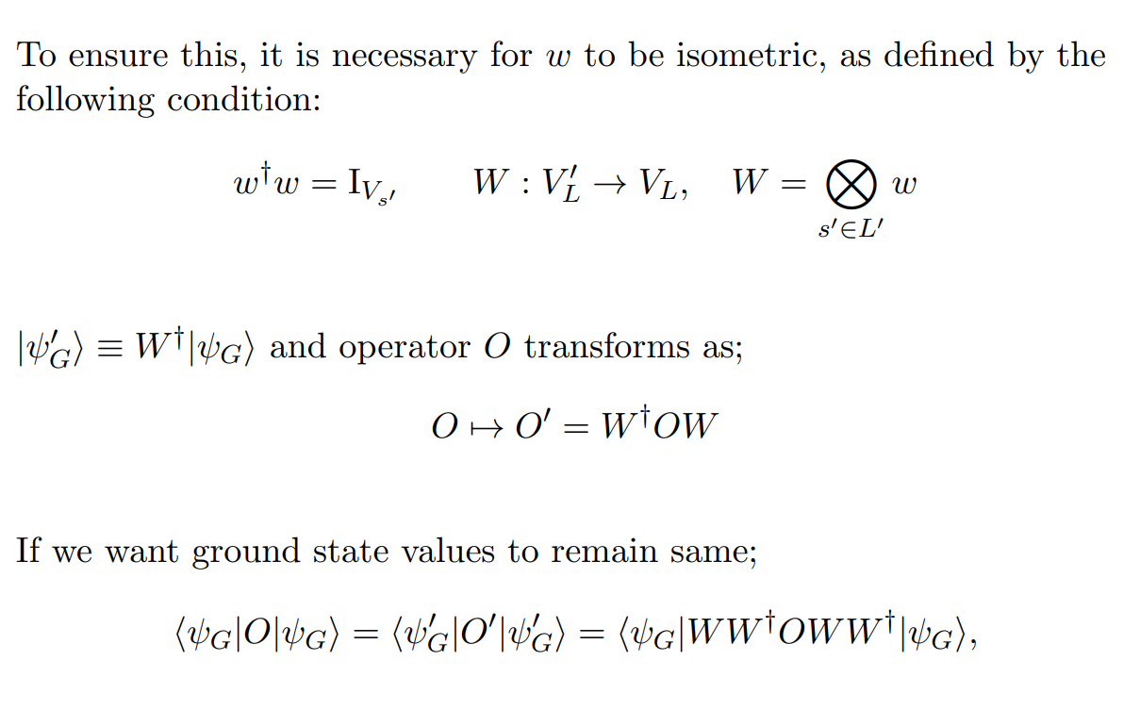
Renormalization
Coarse-graining of 1D lattice

Slide 17
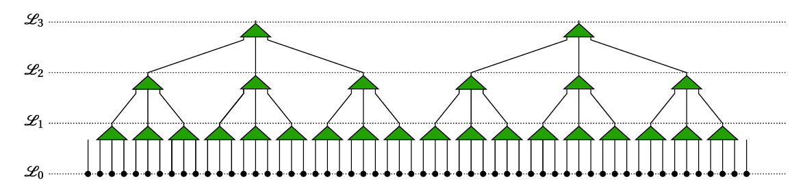
Renormalization
Renormalized group flow

Slide 18
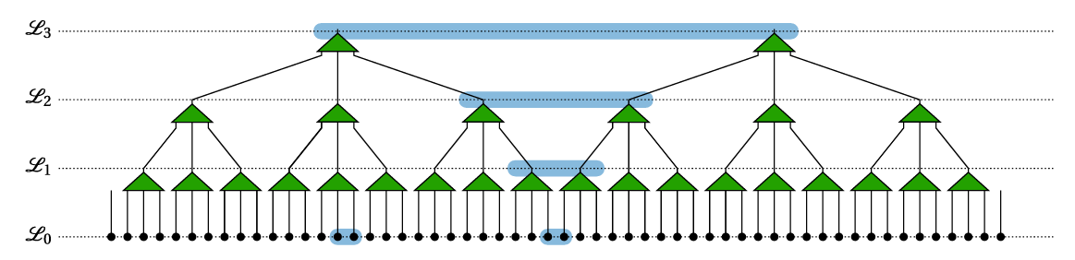
Renormalization
Renormalization group flow

Slide 19
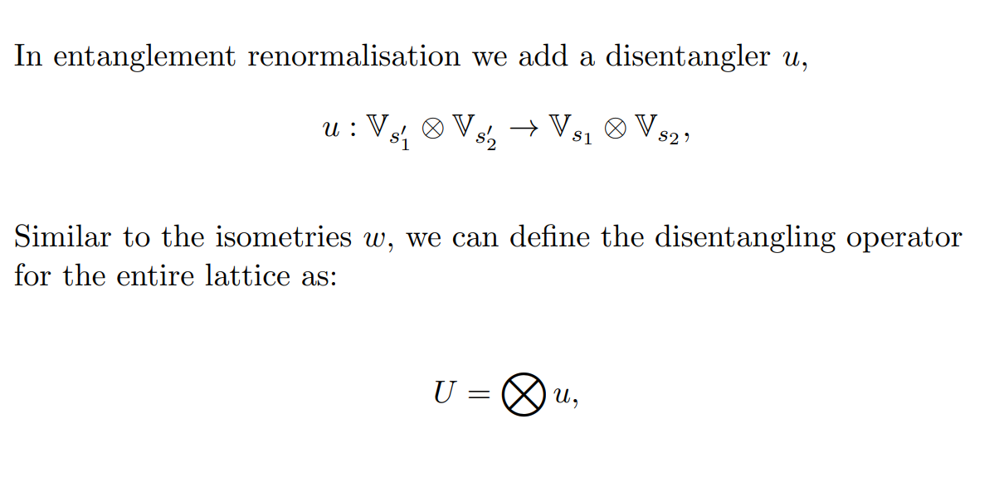
Renormalization
Entanglement Renormalization

Slide 20
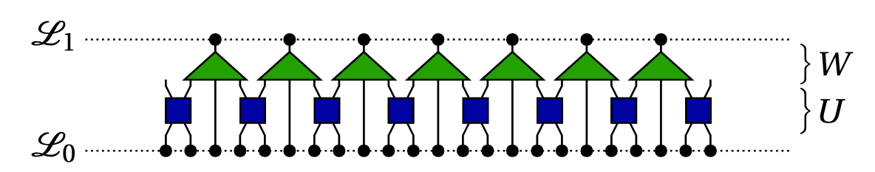
Renormalization
Entanglement Renormalization

Slide 21
The Ansatz
MERA

Slide 22
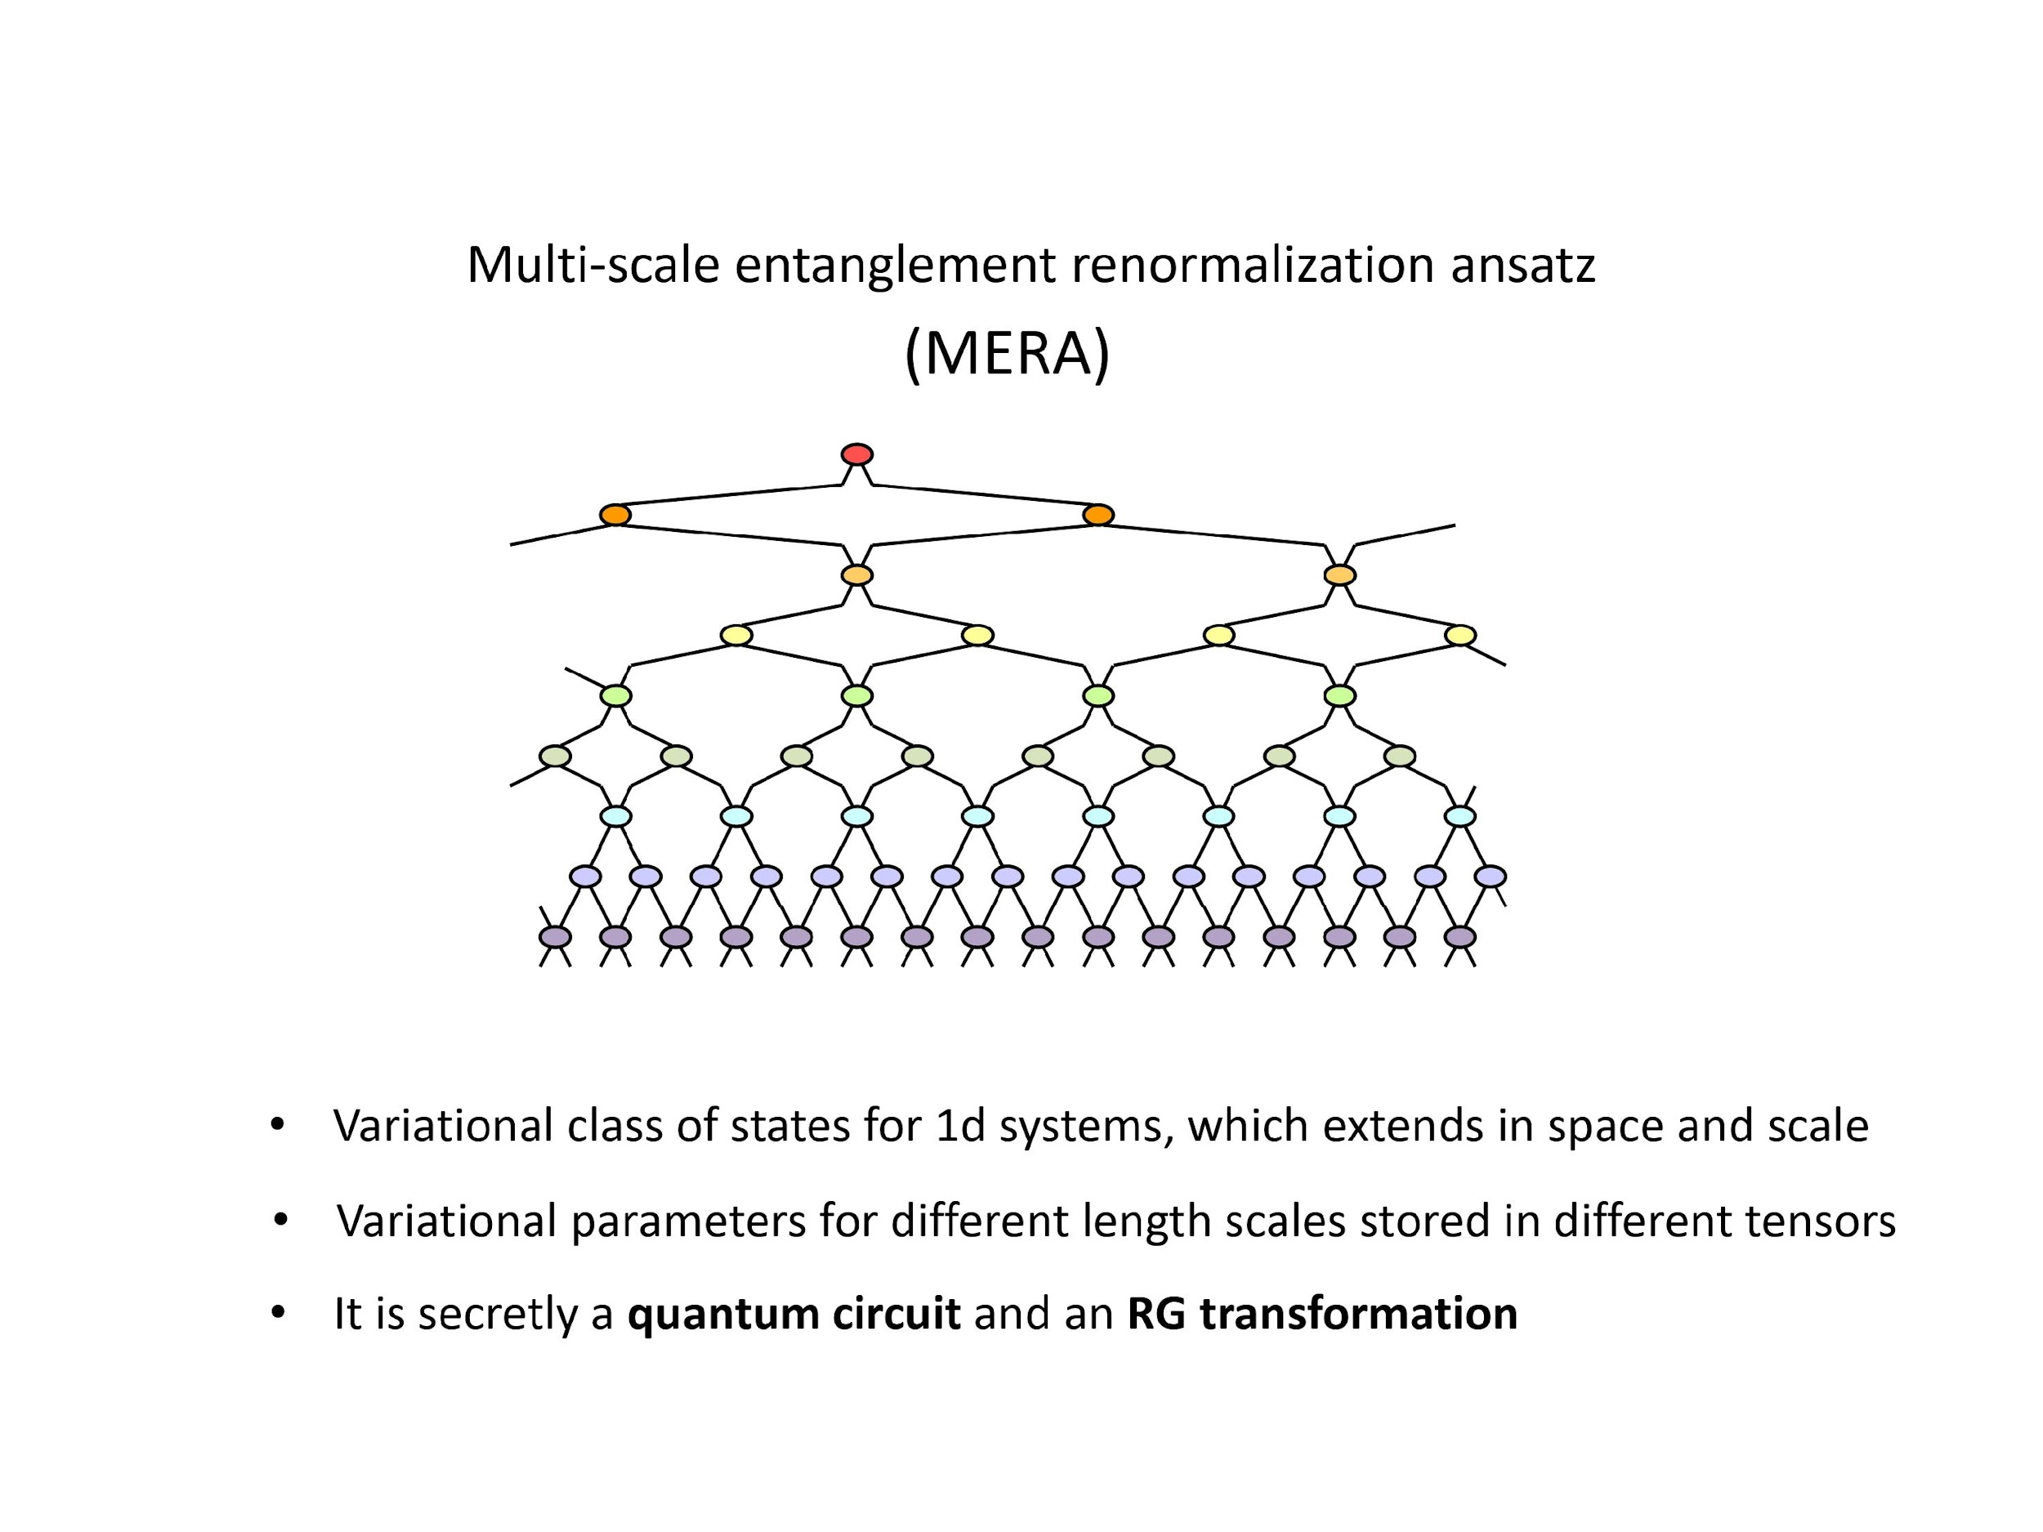
MERA

Slide 23
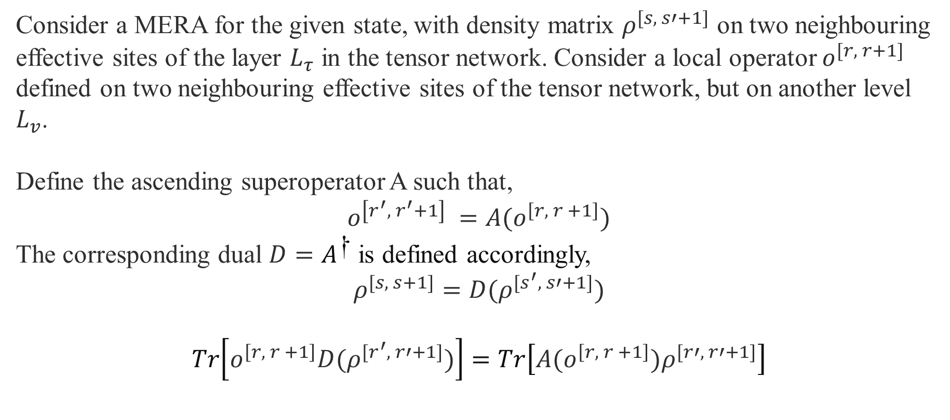
MERA
Observables

Slide 24
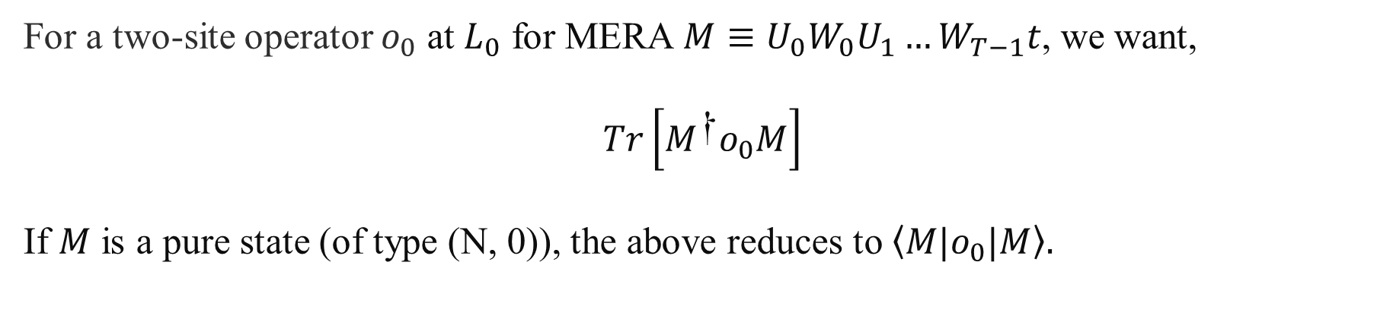
MERA
Observables

Slide 25
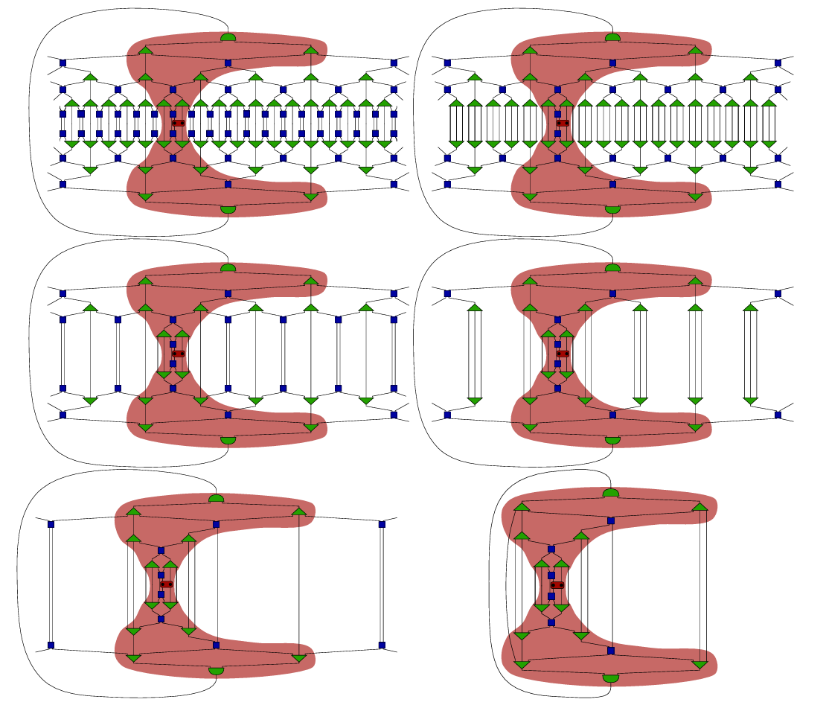
MERA
Observables

Slide 26
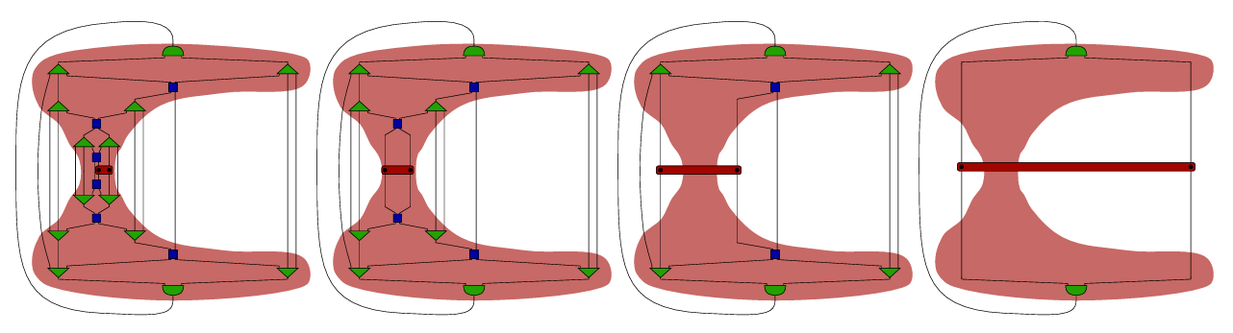
MERA

Slide 27
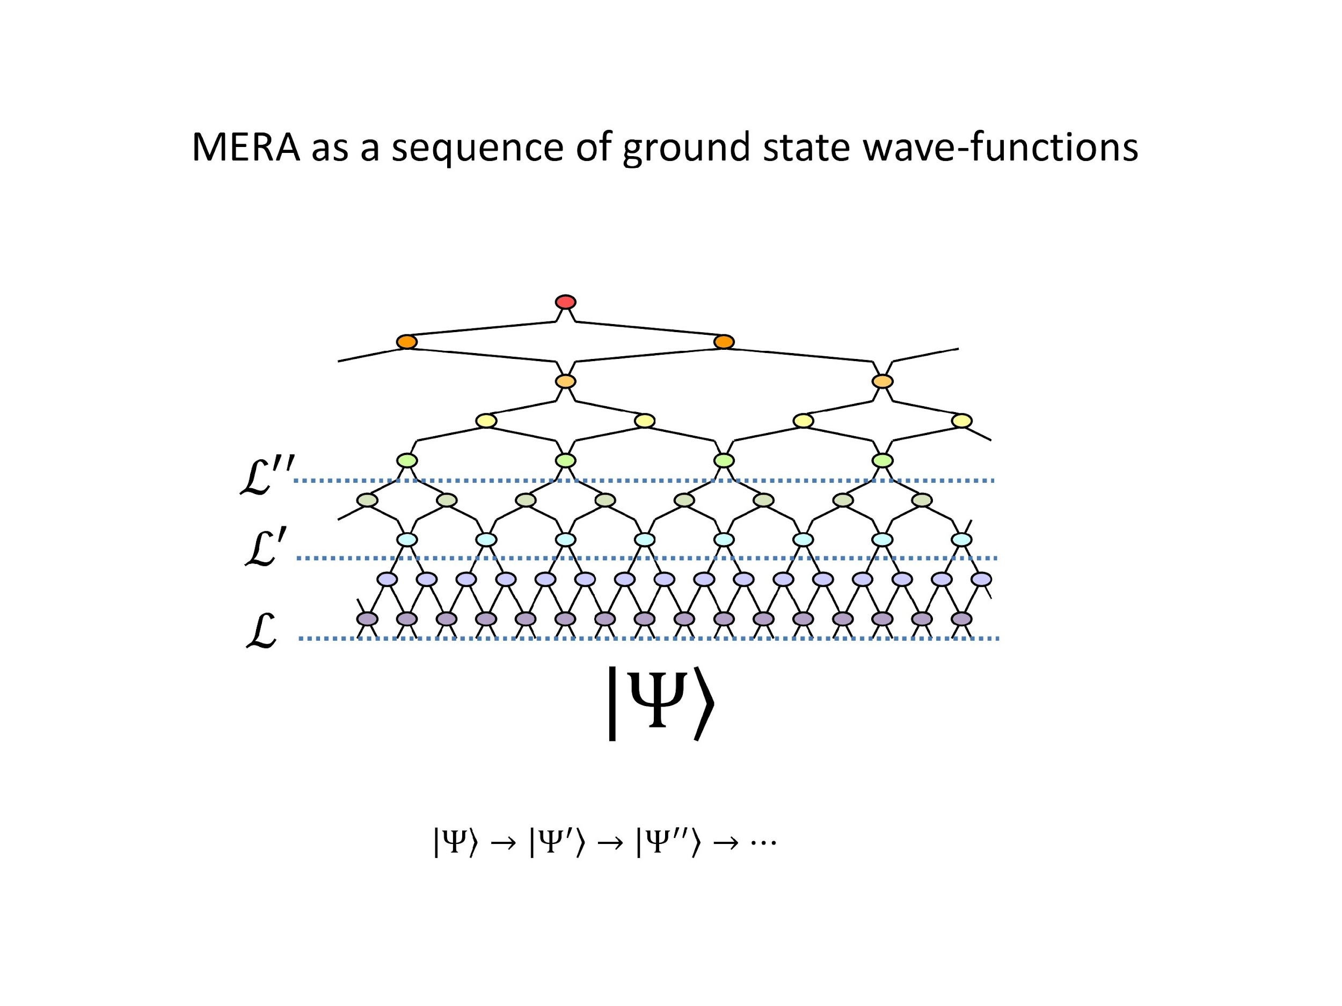
MERA

Slide 28
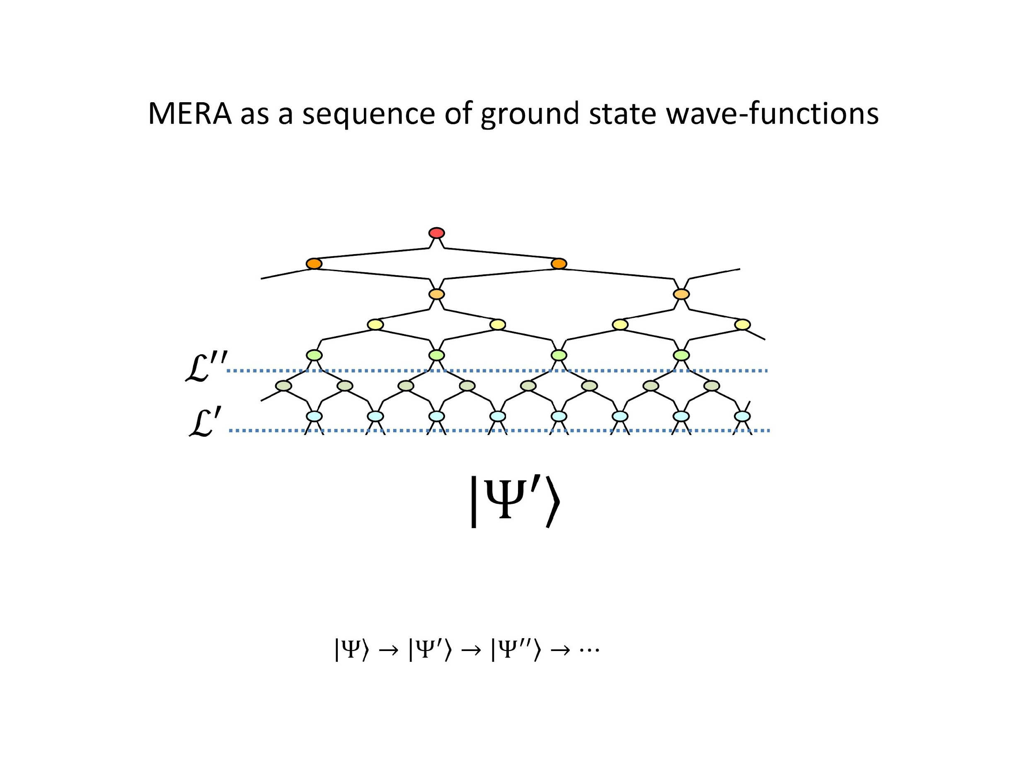
MERA

Slide 29
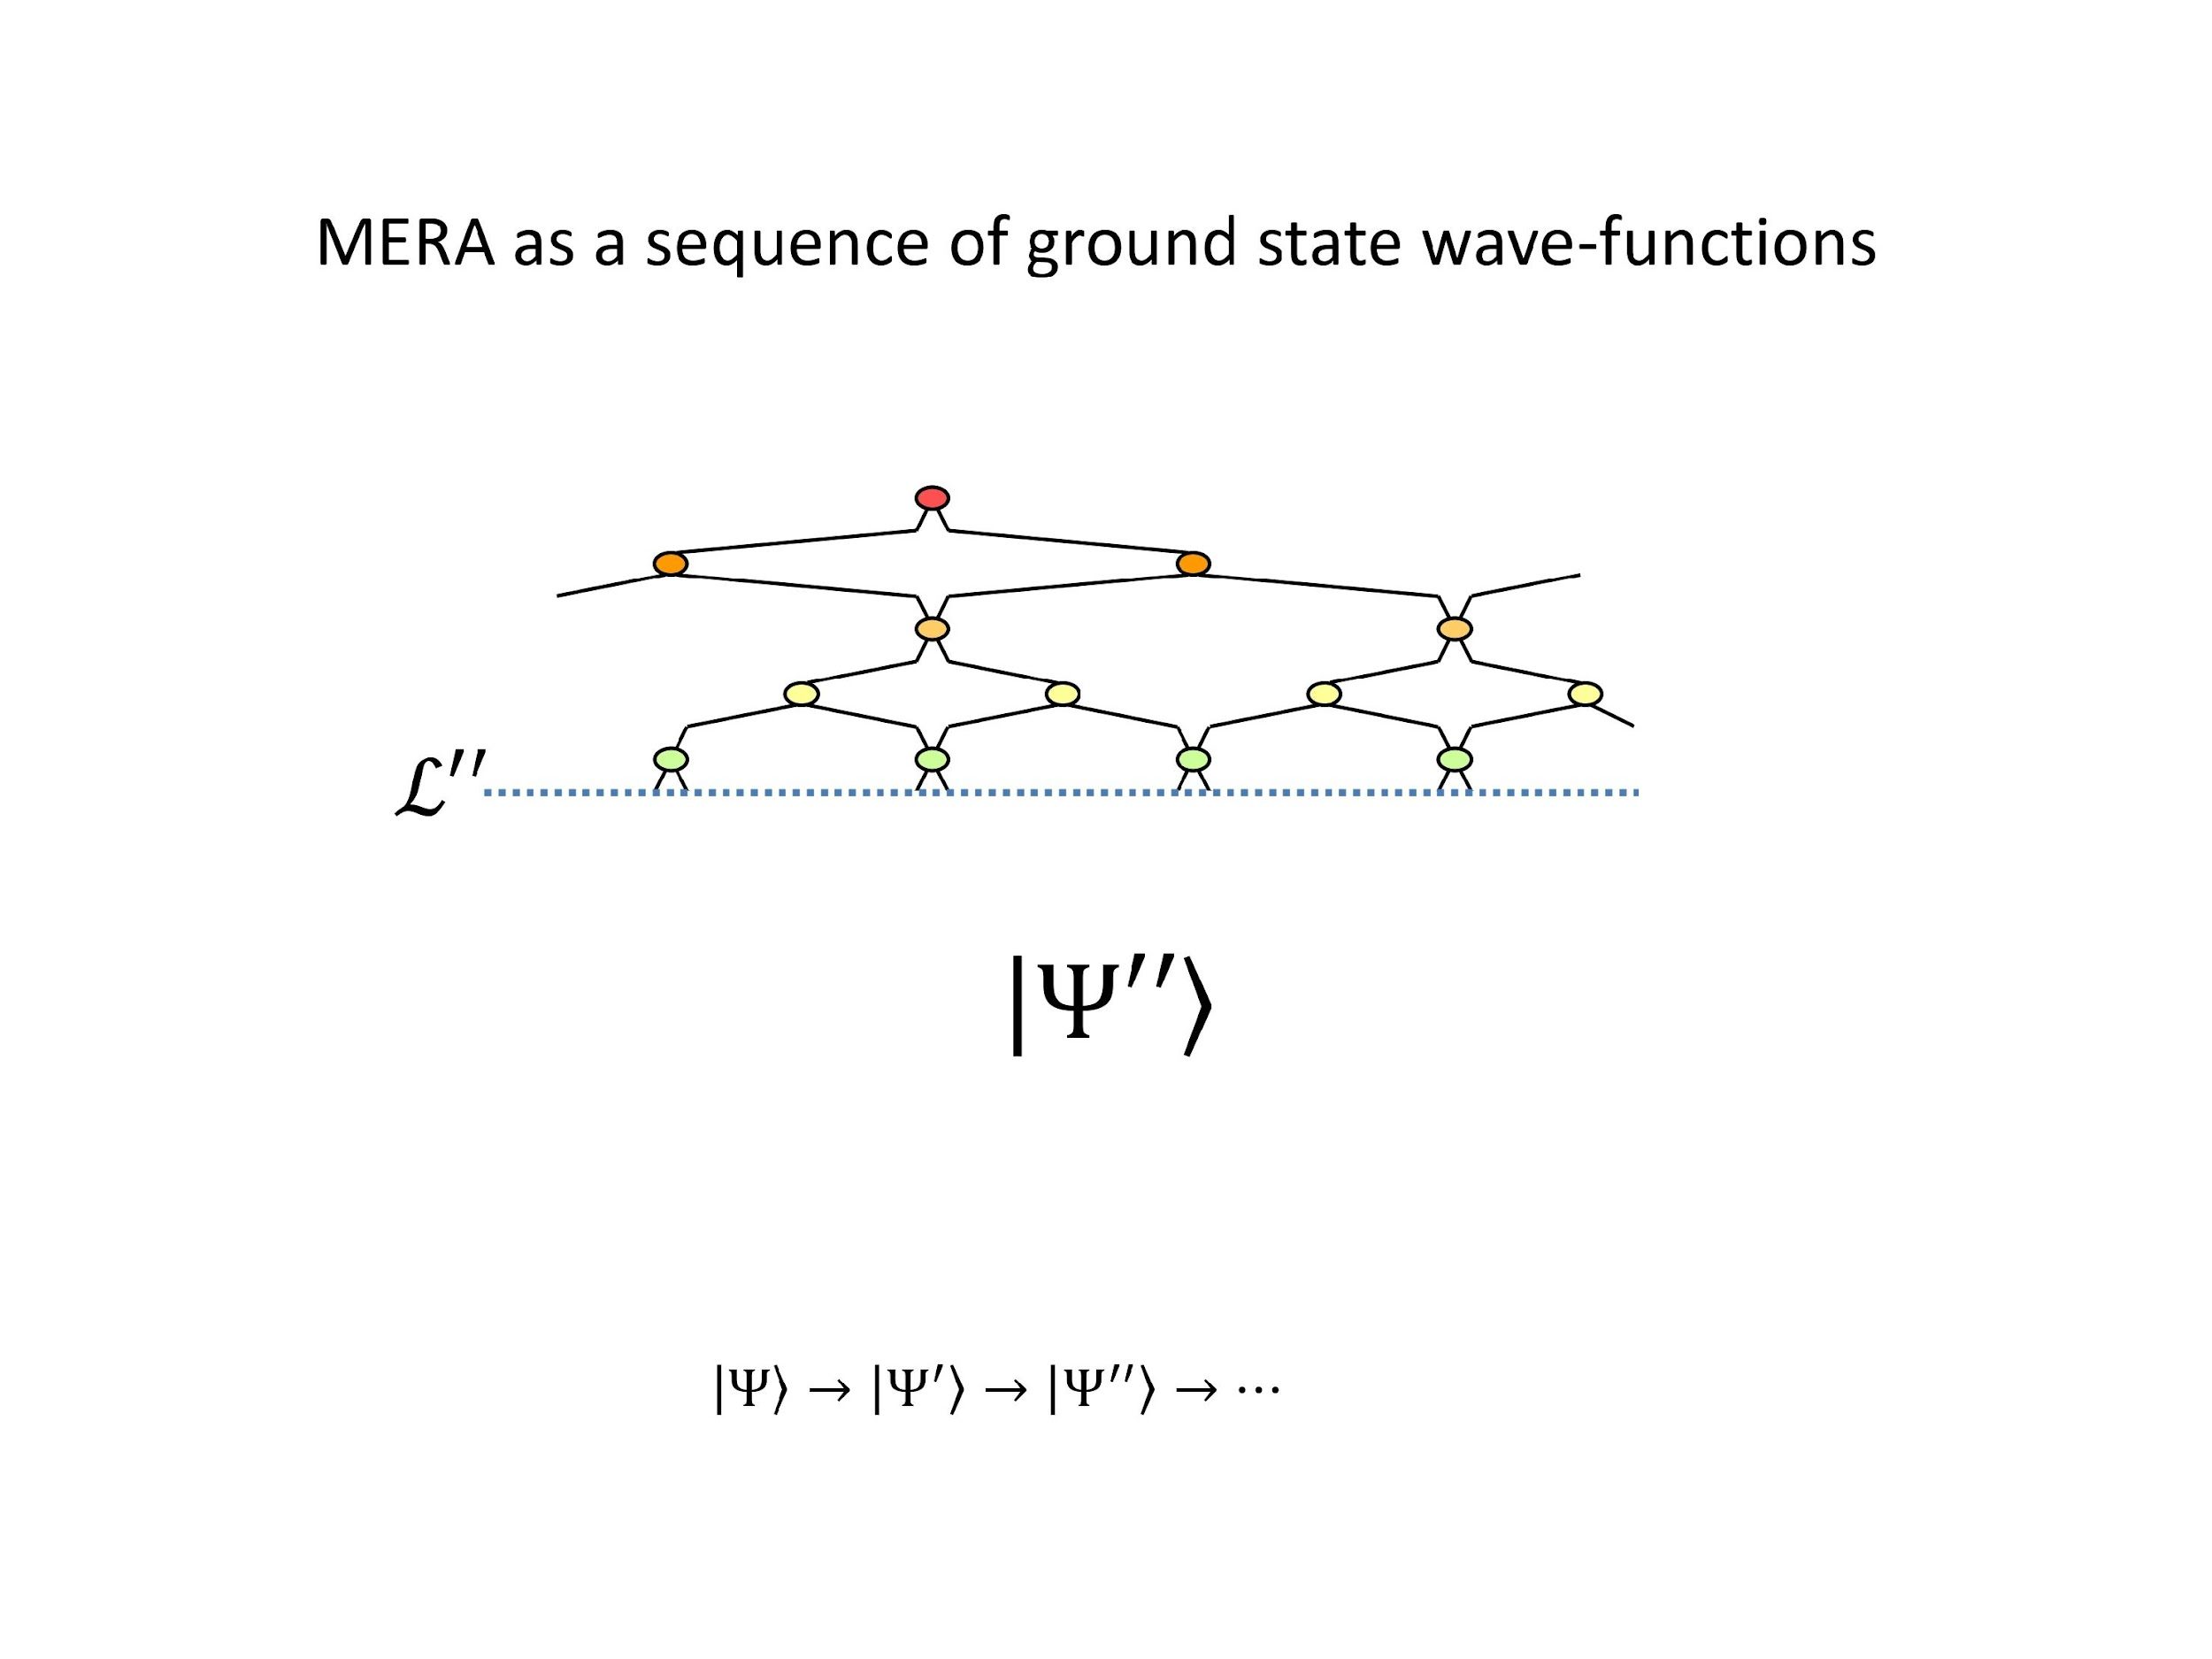
MERA

Slide 30
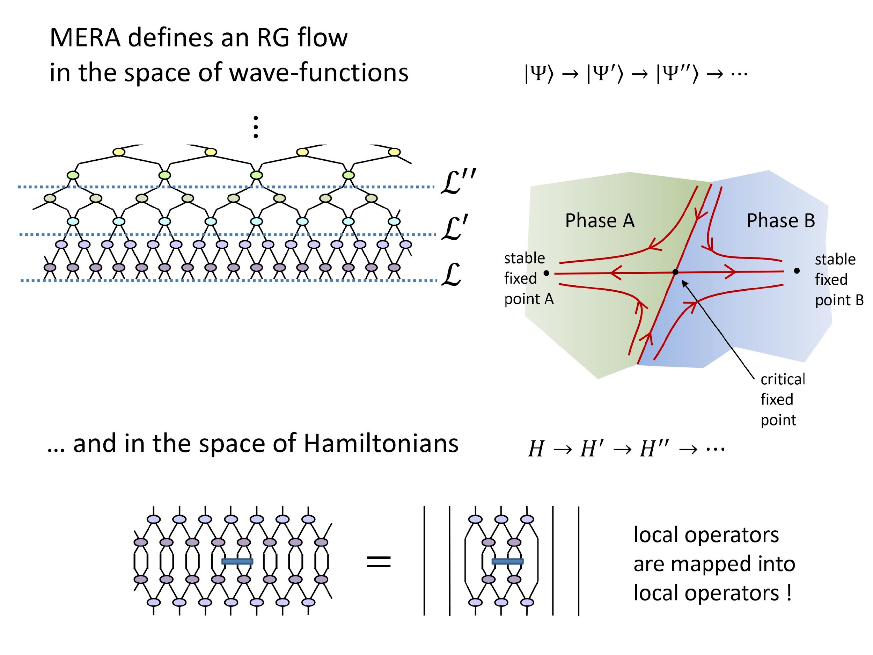
MERA

Slide 31
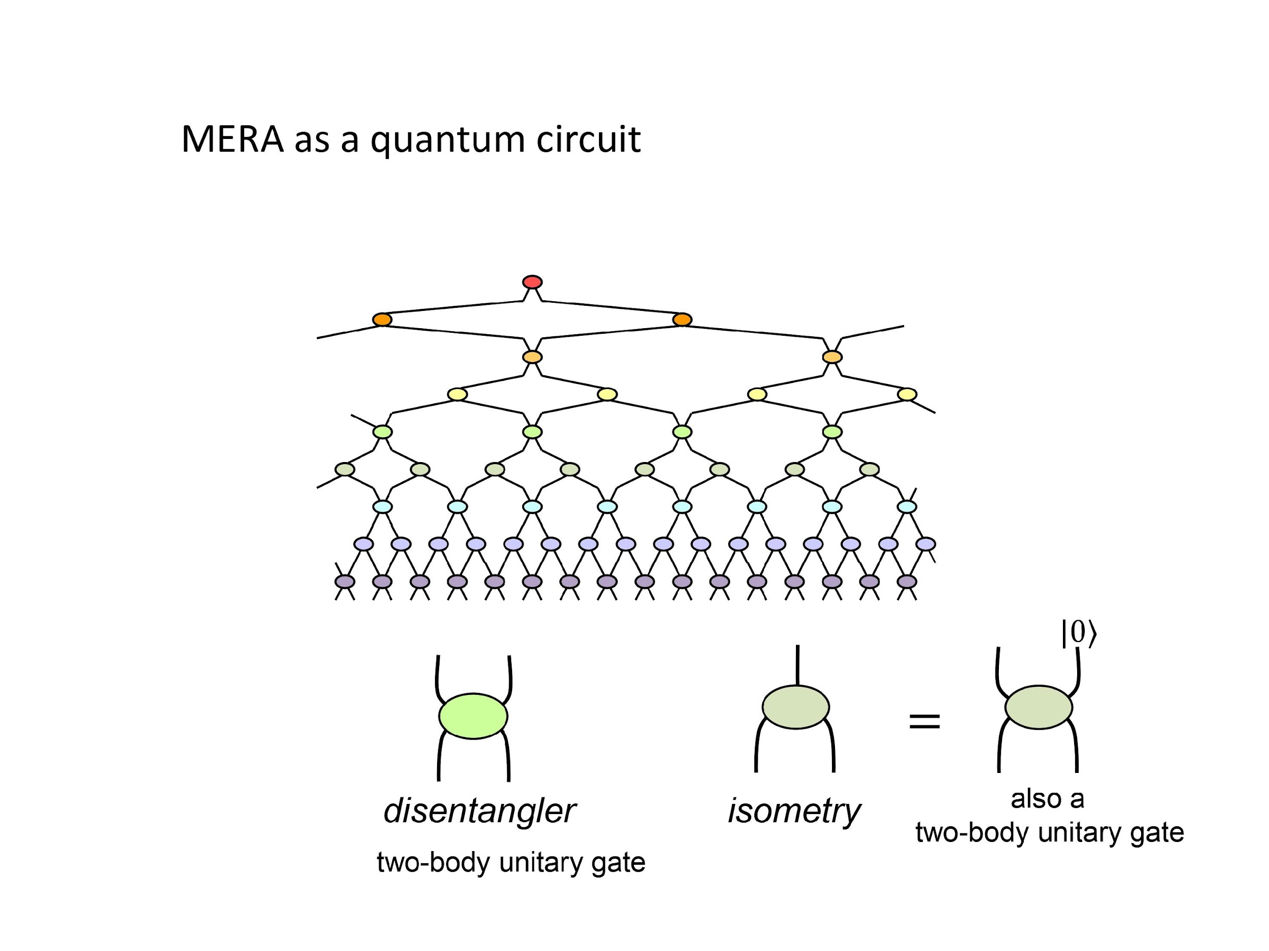
MERA

Slide 32
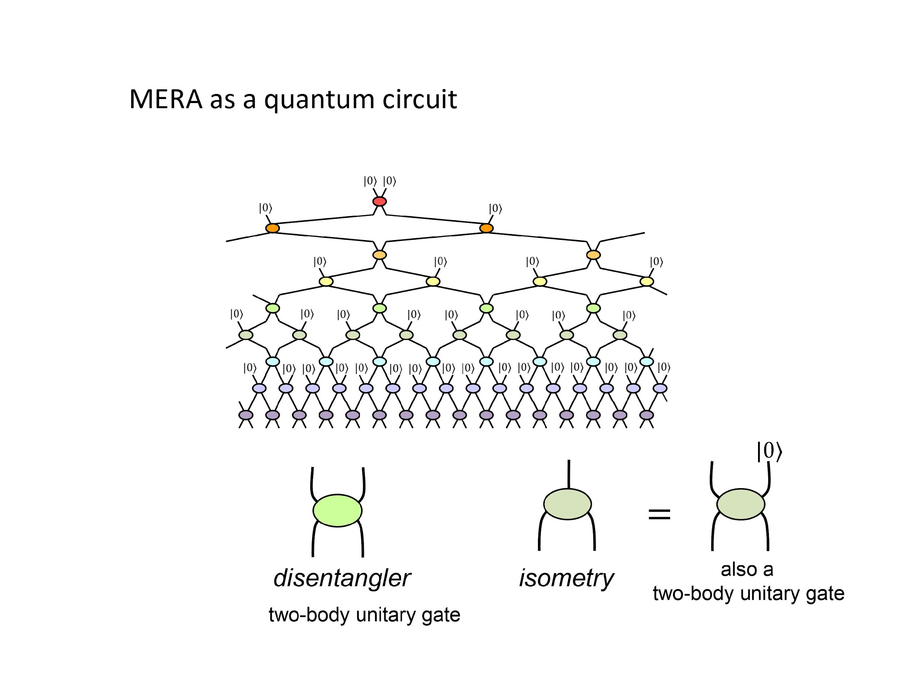
MERA

Slide 33
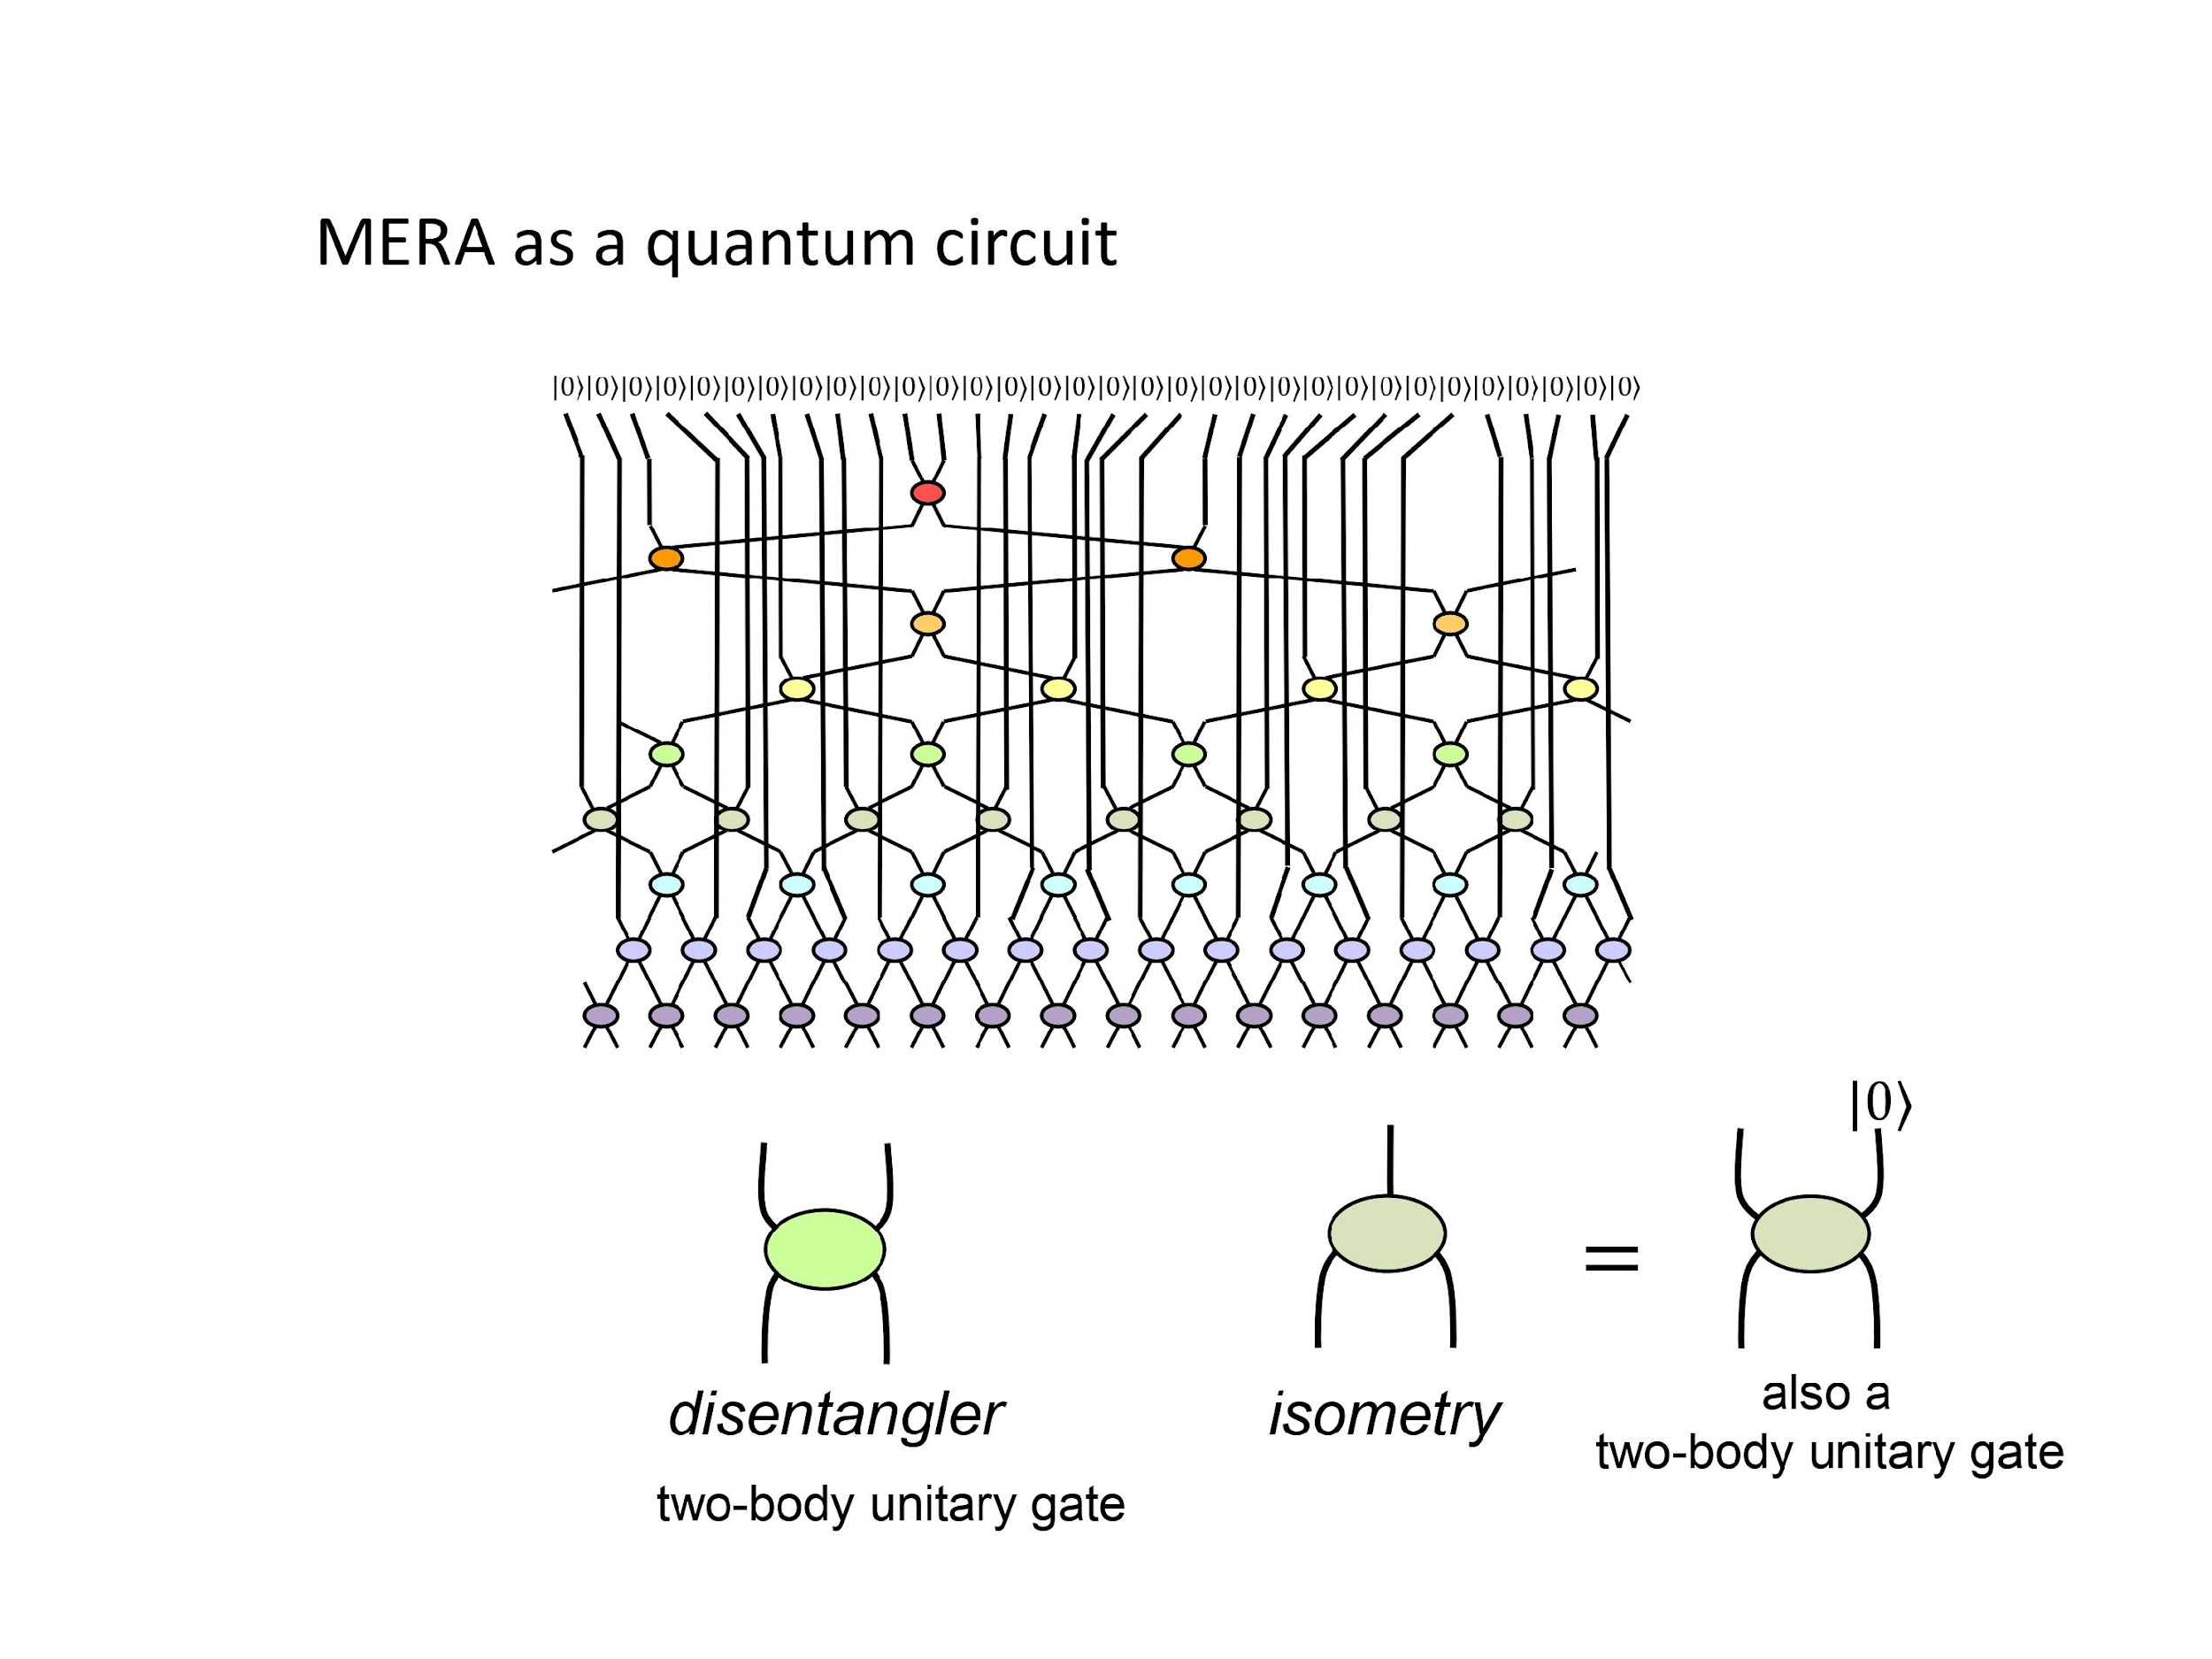
MERA

Slide 34
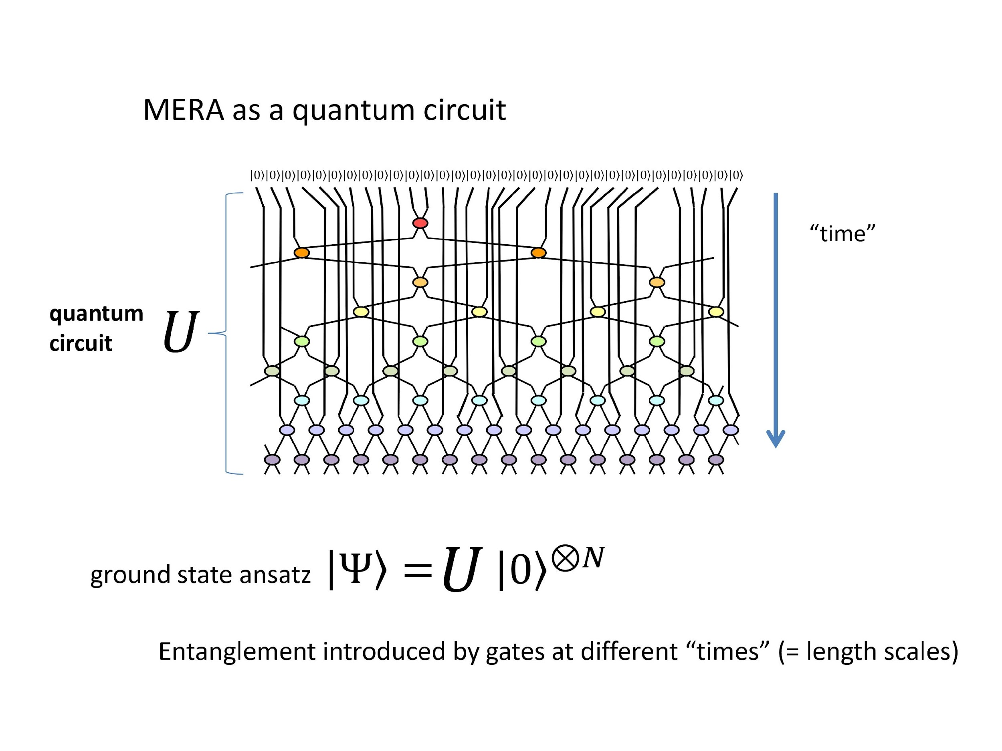
MERA

Slide 35
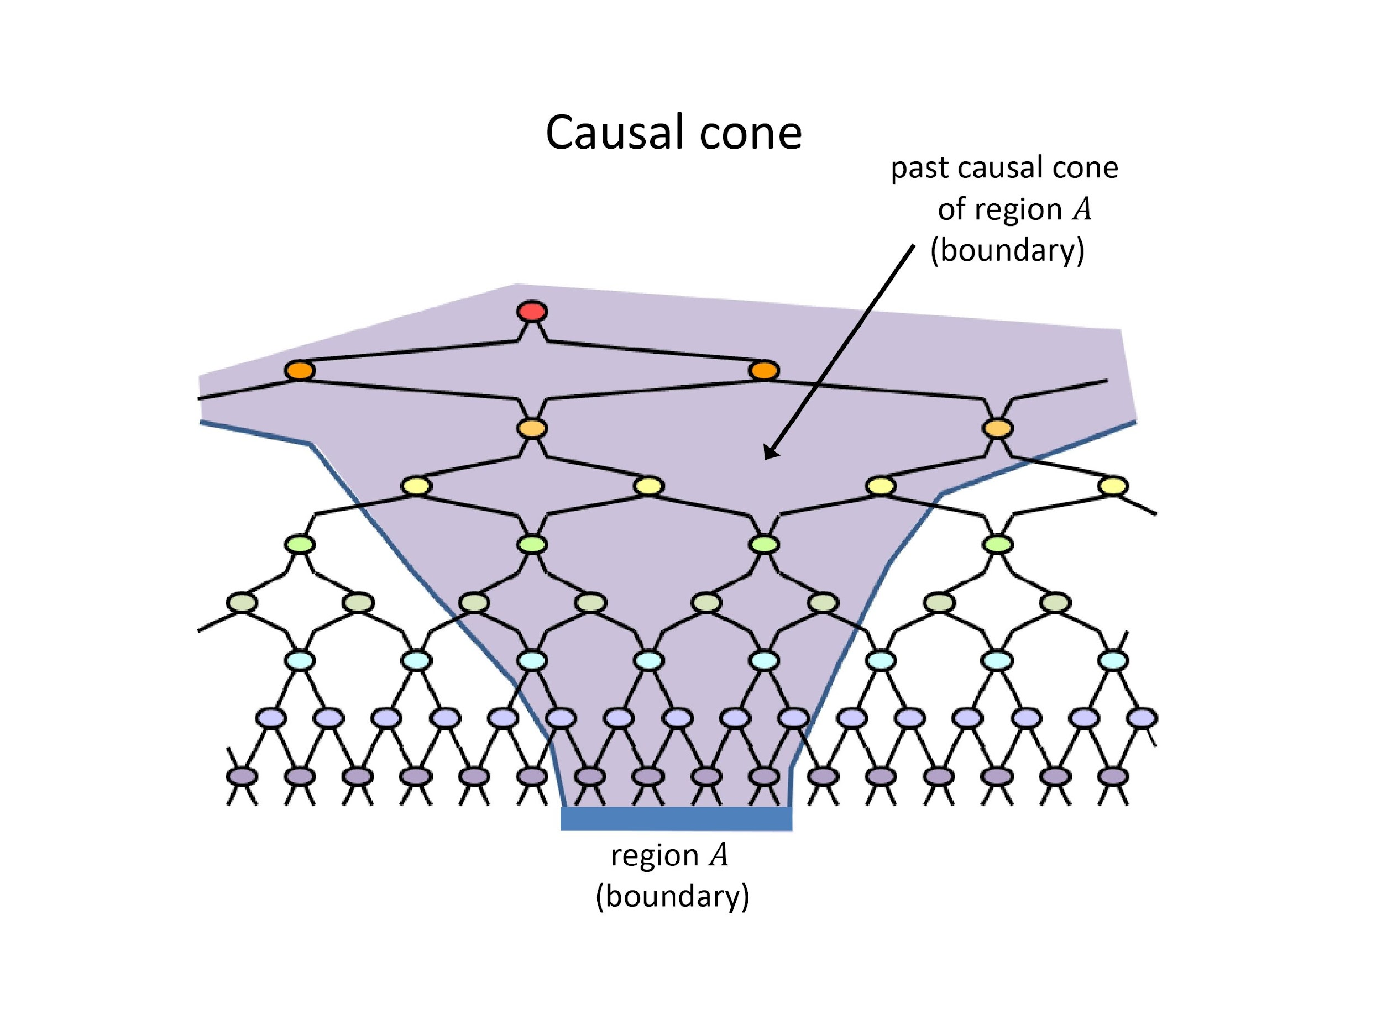
MERA

Slide 36
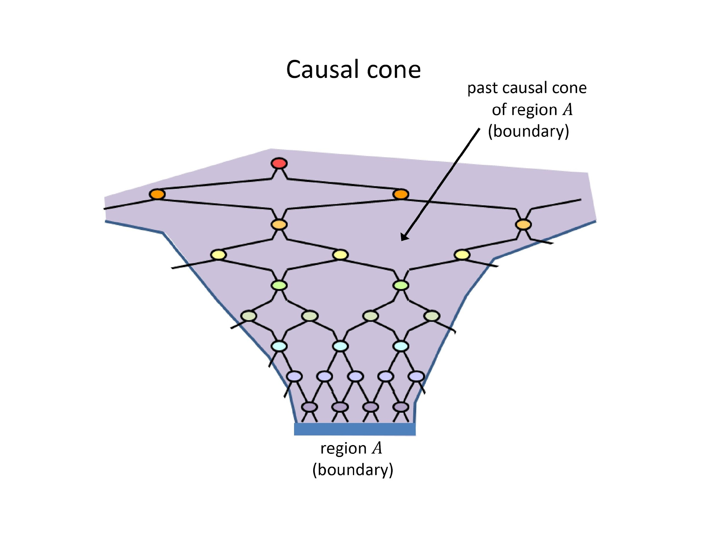
MERA

Slide 37
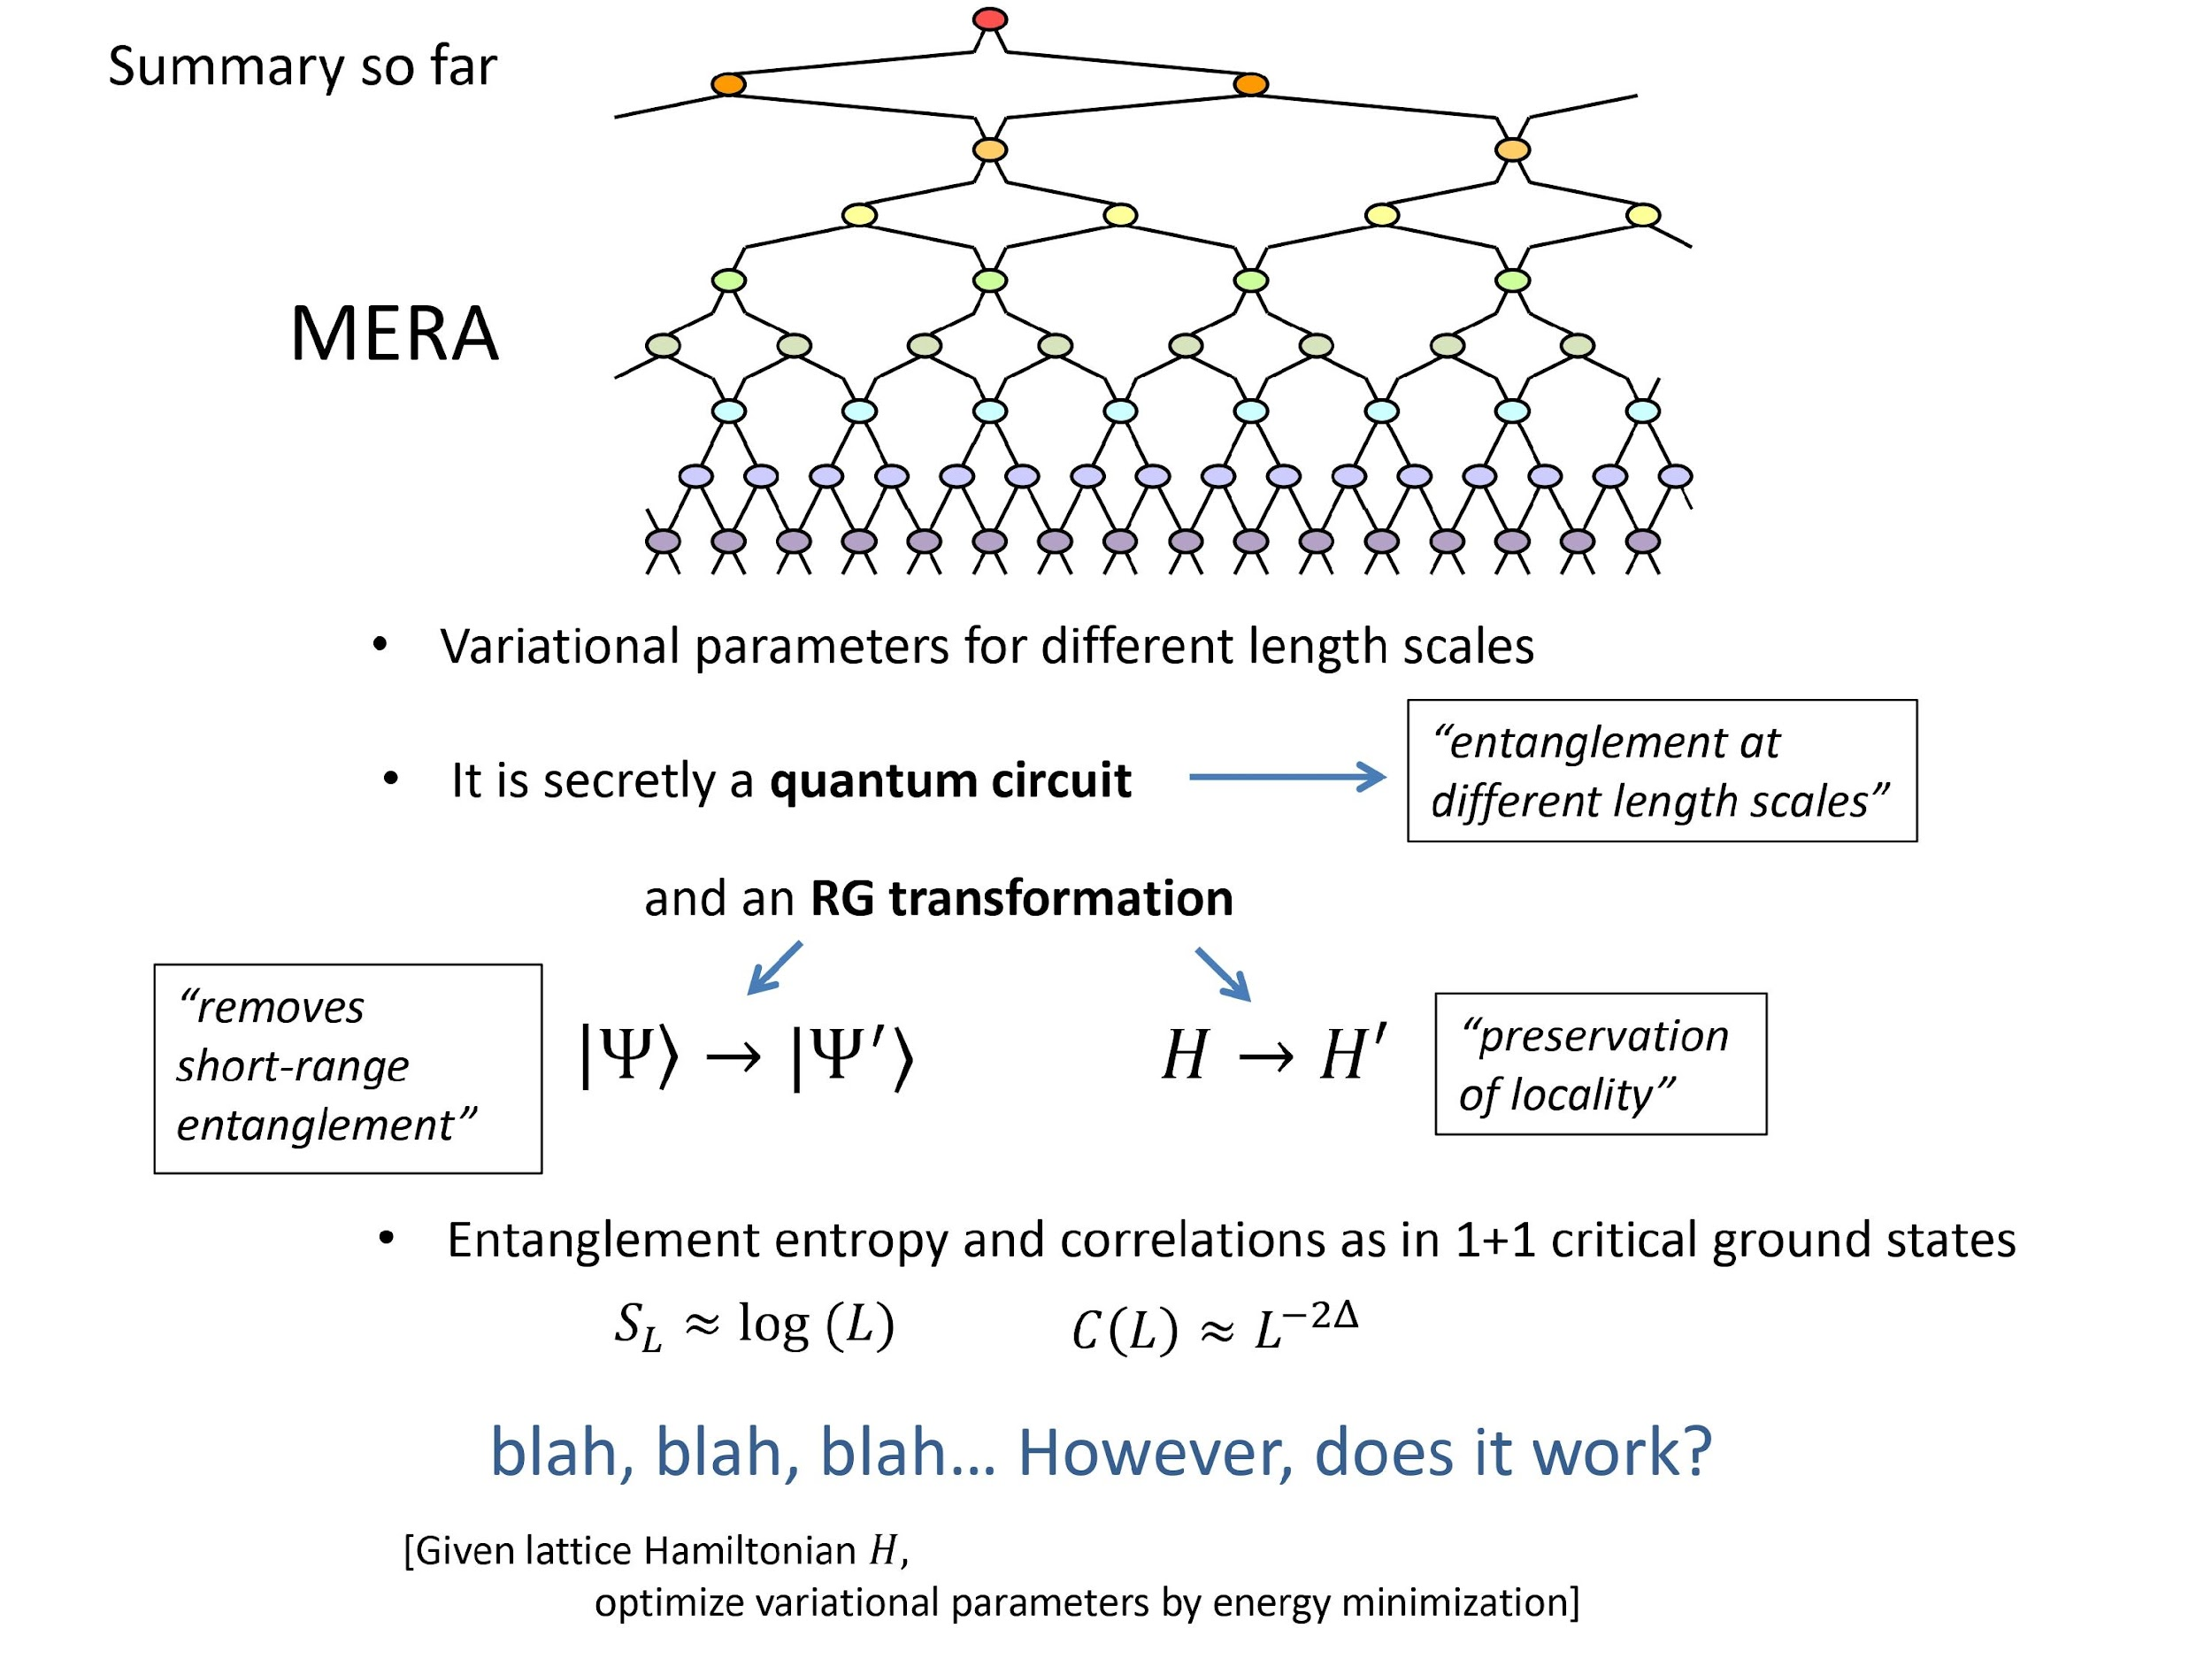
MERA

Slide 38
Results

Slide 39
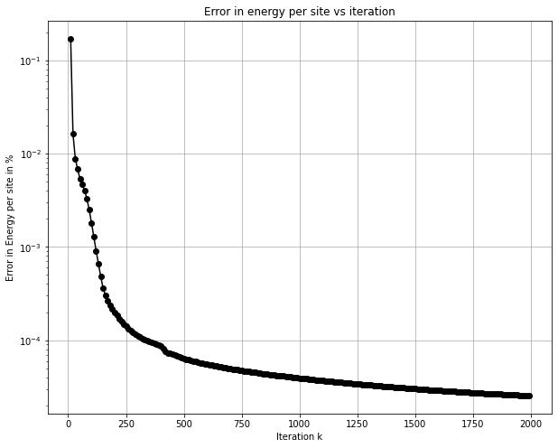
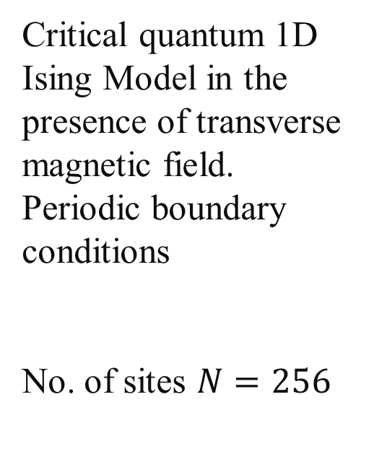
Results

Slide 40
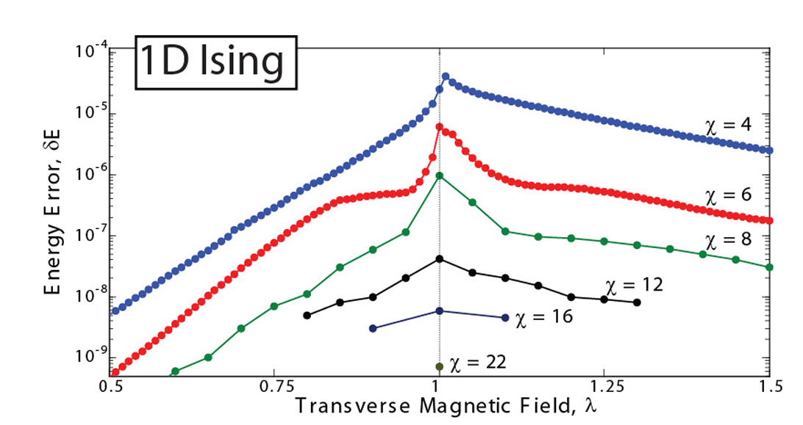
Results

Slide 41
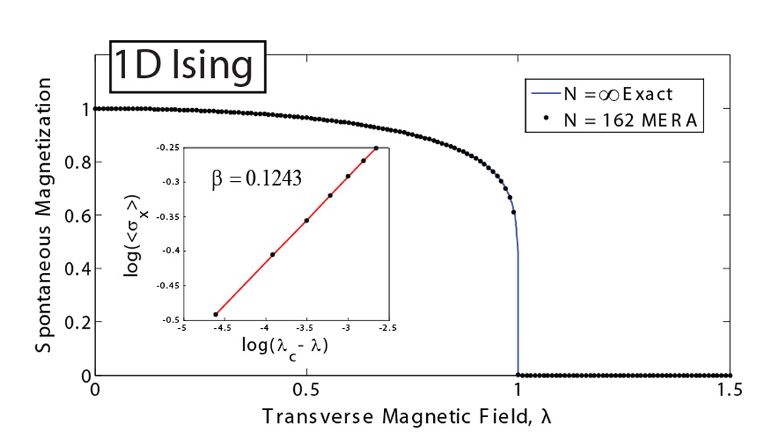
Results

Slide 42
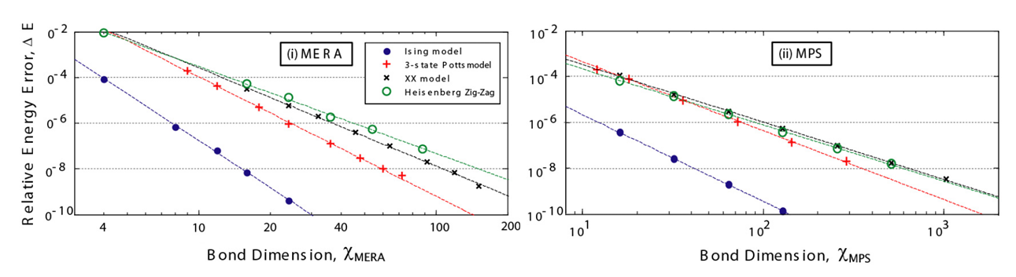
Results

Slide 43
Extensions, applications

Slide 44
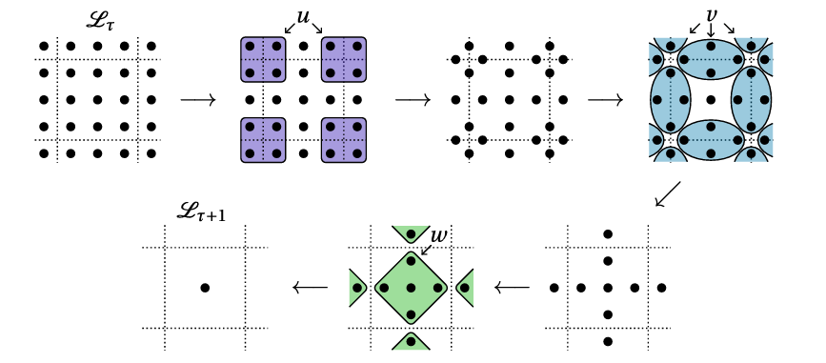
Extensions
2-D MERA

Slide 45
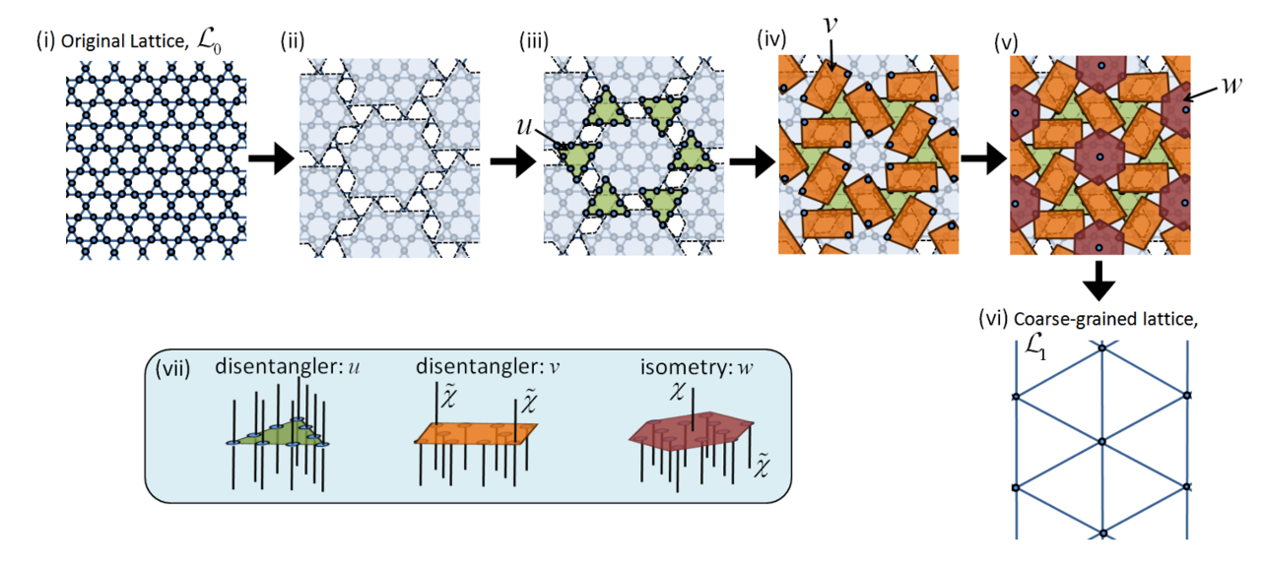
Extensions

Slide 46
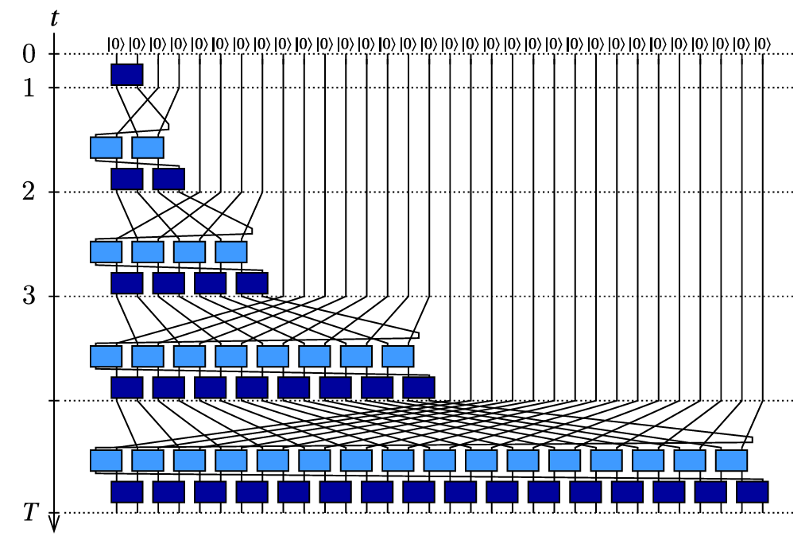
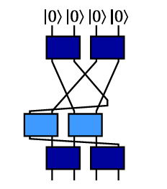
Extensions
Branching MERA

Slide 47
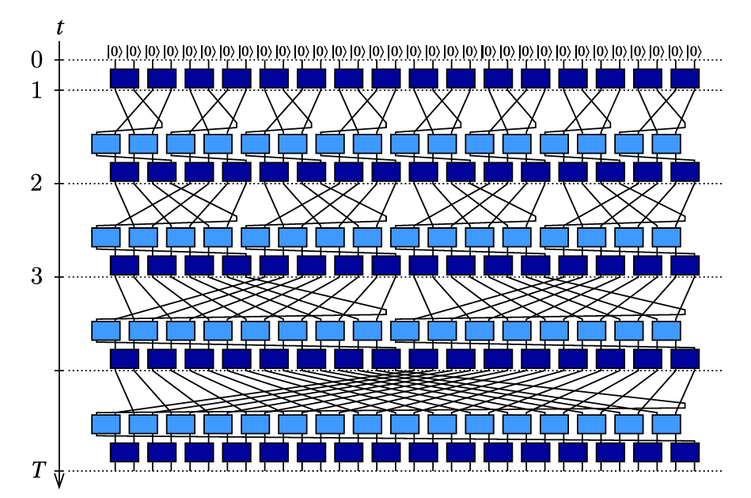
Extensions
Branching MERA

Slide 48
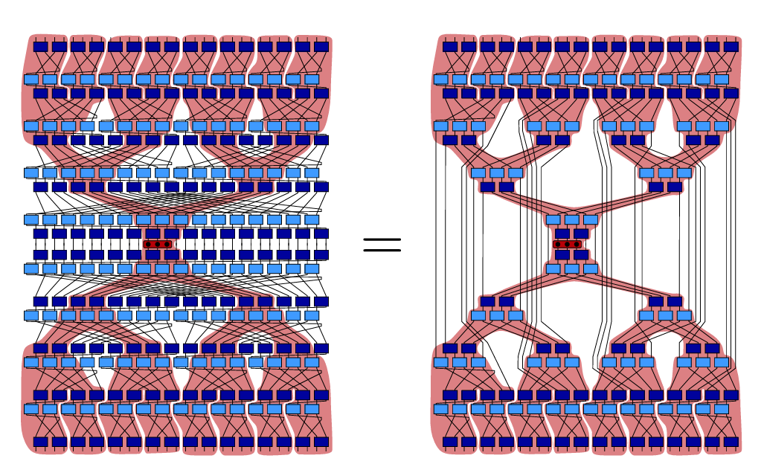
Extensions
Branching MERA

Slide 49
Thank You

